Slide 1
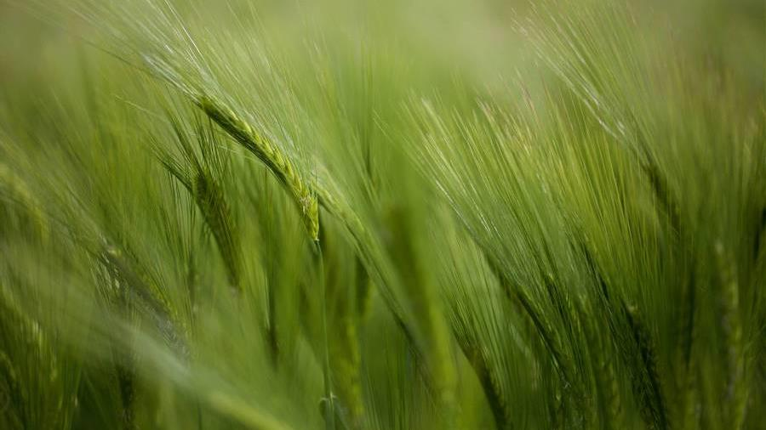
Summer in the Psalms
Books 3 and 4

Slide 2
The Book of Psalms
The Prayer and Praise Book of God’s People

Slide 3
Romans 15:4
For whatever was written in earlier times was written for our instruction, so that through perseverance and the encouragement of the Scriptures we might have hope.

Slide 4
1 Corinthians 10:11
Now these things happened to them as an example, and they were written for our instruction, upon whom the ends of the ages have come.

Slide 5
2 Timothy 3:14-17
14 You, however, continue in the things you have learned and become convinced of, knowing from whom you have learned them, 15 and that from childhood you have known the sacred writings which are able to give you the wisdom that leads to salvation through faith which is in Christ Jesus. 16 All Scripture is inspired by God and profitable for teaching, for reproof, for correction, for training in righteousness; 17 so that the man of God may be adequate, equipped for every good work.

Slide 6
Why Study the Psalms?
Ephesians 5:19
…speaking to one another in psalms and hymns and spiritual songs, singing and making melody with your heart to the Lord;
Colossians 3:16
Let the word of Christ richly dwell within you, with all wisdom teaching and admonishing one another with psalms and hymns and spiritual songs, singing with thankfulness in your hearts to God.
James 5:13
Is anyone among you suffering? Then he must pray. Is anyone cheerful? He is to sing praises [psalms].

Slide 7
The Book of Psalms serves as…
The Christian's “hymnal” to assist us in our praise to God
The Christian's “prayer book” in which we learn how to approach God in prayer
The Christian's “book of evidences” to strengthen our faith in Jesus Christ
The Christian's “training guide” for living holy and righteous lives before God

Slide 8
The Aim of This Study of Psalms
Become more familiar with Old Testament poetry
Develop an appreciation and working knowledge of the Psalms
Glean a clearer picture of God's character
Learn more of Christ in prophecy
Consider examples of fulfilled prophecies

Slide 9
Luke 24:13-47
Luke 24:25-27
25 And He said to them, "O foolish men and slow of heart to believe in all that the prophets have spoken! 26 "Was it not necessary for the Christ to suffer these things and to enter into His glory?" 27 Then beginning with Moses and with all the prophets, He explained to them the things concerning Himself in all the Scriptures.
Luke 24:44-45
44 Now He said to them, "These are My words which I spoke to you while I was still with you, that all things which are written about Me in the Law of Moses and the Prophets and the Psalms must be fulfilled." 45 Then He opened their minds to understand the Scriptures…

Slide 10
THE LAW (TORAH)
The Law includes the five books of the Pentateuch (Genesis, Exodus, Leviticus, Numbers, Deuteronomy).
THE PROPHETS (NEVI’IM)
The Prophets comprises the Former Prophets (Joshua, Judges, 1 and 2 Samuel [counted as one book], 1 and 2 Kings [counted as one book]) and the Latter Prophets (Isaiah, Jeremiah, Ezekiel, the Twelve Minor Prophets [counted as one book]).
THE WRITINGS/Psalms (KETHUVIM)
The Writings consists of Psalms, Proverbs, Job, the Song of Songs, Ruth, Lamentations, Ecclesiastes, Esther, Daniel, Ezra-Nehemiah (counted as one book), 1 and 2 Chronicles (counted as one book)—24 books in total.

Slide 11
Acts 2:14-36 (Peter’s First Sermon)
Peter quotes from the Prophets – Joel 2:28-32 (Acts 2:17-21)
Peter quotes from Psalm 16:8-11 (Acts 2:25-28)
Peter quotes from Psalm 110:1 (Acts 2:34-35)

Slide 12
Characteristics of Hebrew Poetry
The Use of “Thought Rhyme”
Synonymous parallelism- The thought of first line is repeated in the second line, expressed in different words for the sake of emphasis. A good example is found in Psalm 24:2...
For He has founded it upon the seas
And established it upon the rivers. (same idea, reworded)

Slide 13
Characteristics of Hebrew Poetry
Antithetical parallelism - The truth presented in one line is strengthened by a contrasting statement in the next line. Consider this example from Psalm 1:6...
For the Lord knows the way of the righteous,
But the way of the wicked will perish. (note the contrast)

Slide 14
Characteristics of Hebrew Poetry
Synthetic parallelism - The first and second lines bear some definite relation to each other (such as cause and effect, or proposition and conclusion). A good example is Psalm 119:11...
Your word I have treasured in my heart, (cause)
That I may not sin against You. (effect)

Slide 15
Characteristics of Hebrew Poetry
Progressive parallelism - There are several varieties of this form, the most common being:
Stair-like - Composed of several lines, each providing a complete element of the aggregate or composite thought. Notice Psalm 1:1...
How blessed is the man…
who does not walk in the counsel of the wicked,
Nor stand in the path of sinners,
Nor sit in the seat of scoffers! (note the progression)

Slide 16
Characteristics of Hebrew Poetry
Progressive parallelism - There are several varieties of this form, the most common being:
Climatic - Here the principal idea in the first line is repeated and expanded to complete the thought. An example is found in Psalm 29:1...
Ascribe to the Lord, O sons of the mighty, (ascribe what?)
Ascribe to the Lord glory and strength. (the answer)

Slide 17
Characteristics of Hebrew Poetry
Introverted parallelism - The first line is closely related in thought to the fourth, and the second to the third. For example, consider Psalm 91:14...
Because he has loved Me, (corresponds to line 4)
therefore I will deliver him; (corresponds to line 3)
I will set him securely on high, (corresponds to line 2)
because he has known My name. (corresponds to line 1)

Slide 18
Characteristics of Hebrew Poetry
Lack of Poetic Rhyme

Slide 19
Characteristics of Hebrew Poetry
Use of Figurative Expression
The figure must be accepted and dealt with as a figure of speech, not as a literal statement.
Psalms 18:31
For who is God, but the LORD? And who is a rock, except our God…
Psalms 51:4
Against You, You only, I have sinned.

Slide 20
Characteristics of Hebrew Poetry
Use of Figurative Expression
The figure must be interpreted in light of its meaning in the setting in which it was used
Psalm 23:4
“…the valley of the shadow of death.”

Slide 21
Background Material on the Psalms
The Origin Of The Word “Psalm”
The Greek word is “psalmos,” from the Hebrew word “zmr” meaning “to pluck;” i.e., taking hold of the strings of an instrument with the fingers.
Ephesians 5:19
…speaking to one another in psalms and hymns and spiritual songs, singing and making melody with your heart to the Lord;

Slide 22
Background Material on the Psalms
The History of the Psalms
The oldest of the Psalms originate from the time of Moses (1400 B.C.). We have three psalms penned by Moses:
Exodus 15:1-15 - a song of triumph following the crossing of the Red Sea
Deuteronomy 32-33 - a song of exhortation to keep the Law after entering Canaan
Psalm 90 - a song of meditation, reflection, and prayer After Moses, the writing of Psalms had its “peaks” and “valleys”: In David (1000 B.C.), the sacred lyric attained to its full maturity.

Slide 23
Background Material on the Psalms
The Authors of the Psalms
David - Commonly thought to be the author of the book of Psalms, but he actually wrote only about seventy-three (73), less than half.
Asaph - The music director during the reigns of David and Solomon (1 Chronicles 16:1-7). He wrote twelve (12) psalms.
The Sons of Korah - These were Levites who served in the Temple (1 Chronicles 26:1-19). They wrote twelve (12) psalms.
Solomon - At least two (2) psalms are attributed to him (Psalms 72, 127). That he wrote many more is stated in 1 Kings 4:29-32.

Slide 24
Background Material on the Psalms
The Authors of the Psalms
Moses - As indicated above, he wrote the earliest psalms; one is included in Psalms (Psalm 90).
Heman - Contemporary with David and Asaph, and is known as “the singer” (1 Chronicles 6:33). He wrote one psalm (Psalm 88) that has been preserved.
Ethan - A companion with Asaph and Heman in the Temple worship (1 Chronicles 15:19). He wrote one psalm (Psalm 89).
Anonymous - The authorship of forty-eight (48) of the psalms is unknown.

Slide 25
Background Material on the Psalms
The Arrangement of the Psalms
The Psalms were originally collected into five “books,” apparently according to the material found within them:
Book I (Psalms 1-41)
Book II (Psalms 42-72)
Book III (Psalms 73-89)
Book IV (Psalms 90-106)
Book V (Psalms 107-150)

Slide 26
Background Material on the Psalms
The Arrangement of the Psalms
The Psalms can also be arranged into chief “groups”:
Alphabetic or Acrostic - These psalms have lines which in Hebrew start with words whose first letters follow a certain pattern. For example, in Psalm 119 the first eight lines start with words beginning with the Hebrew letter ALEPH, the second eight lines with words beginning with BETH, etc. This may have been done to aid in the memorization of the psalm.
Ethical - These psalms teach moral principles (e.g., Psalm 15).
Hallelujah - These are psalms of praise, beginning and/or ending with “hallelujah” or “praise Yahweh” (e.g., Psalm 103).
Historical - Psalms which review the history of God's dealings with His people (e.g., Psalm 106).

Slide 27
Background Material on the Psalms
The Arrangement of the Psalms
The Psalms can also be arranged into chief “groups”:
Imprecatory - These psalms invoke God to bring punishment or judgment upon one's enemies (e.g., Psalm 69).
Messianic - Psalms pertaining to the coming Messiah (e.g., Psalms 2, 16, 110).
Penitential - These are psalms expressing sorrow for sins that have been committed (e.g., Psalm 51).
Songs Of Ascent (or Songs Of Degrees) - These psalms were possibly sung by pilgrims on the way to Jerusalem to observe the feasts. They are grouped together as Psalms 120-134.

Slide 28
Background Material on the Psalms
The Arrangement of the Psalms
The Psalms can also be arranged into chief “groups”:
Suffering - These psalms are cries of those suffering affliction (e.g., Psalm 102).
Thanksgiving - Psalms of grateful praise to Jehovah for blessings received (e.g., Psalm 100).

Slide 29
Background Material on the Psalms
The Arrangement of the Psalms
3. The various “styles” of the psalms can be described as...
Didactic - Psalms of teaching and instruction (e.g., Psalm 1).
Liturgical - Responsive readings, for use in special services (e.g., Psalm 136).
Meditation - The ancient Hebrews were given to meditation, which spirit finds expression in many of the psalms (e.g., Psalm 119).
Praise and Devotion - Psalms of joyful praise (e.g., Psalm 148).
Prayer and Petition - Psalms which were sung in an attitude of prayer (e.g., Psalm 51).

