Slide 1
Who Do You Say I Am?
Mark 8:27-30
The Authenticity, Affliction and Authority of Jesus Christ, the Son of God

Slide 2
Mark 8:27-30
27 Jesus went out, along with His disciples, to the villages of Caesarea Philippi; and on the way He questioned His disciples, saying to them, "Who do people say that I am?" 28 They told Him, saying, "John the Baptist; and others say Elijah; but others, one of the prophets." 29 And He continued by questioning them, "But who do you say that I am?" Peter answered and said to Him, "You are the Christ." 30 And He warned them to tell no one about Him.

Slide 3
A starting question: Where are we? ^{(8:27a)}
And Jesus went out, along with His disciples, to the villages of Caesarea Philippi

Slide 4
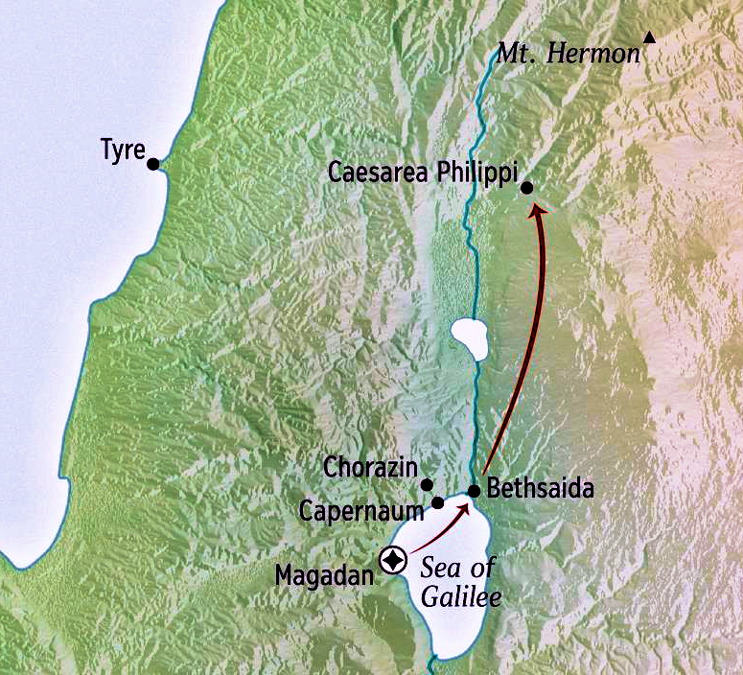
A starting question: Where are we? ^{(8:27a)}
And Jesus went out, along with His disciples, to the villages of Caesarea Philippi

Slide 5
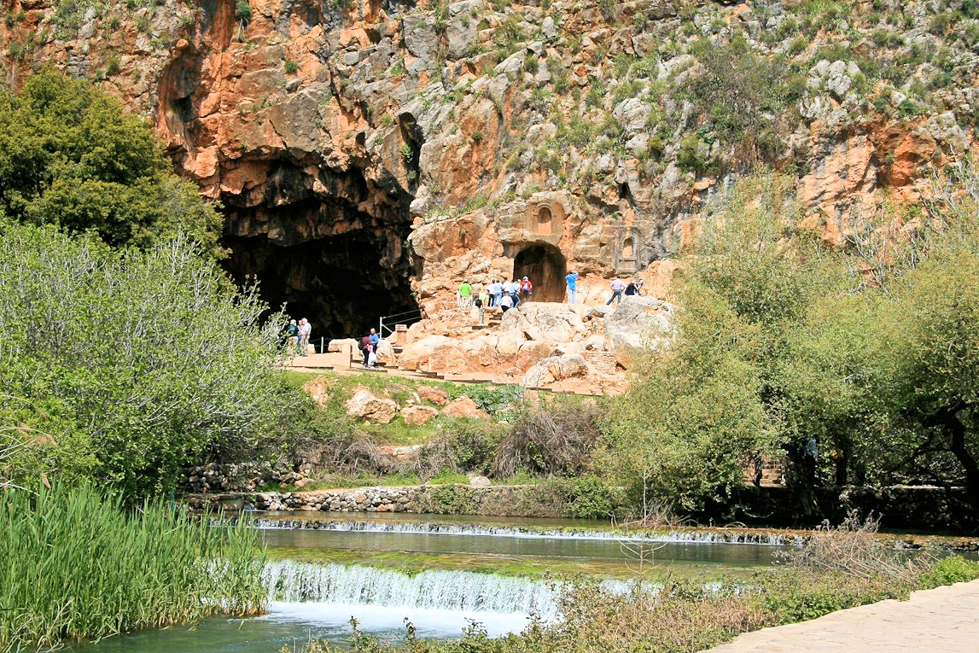
Mark 8:27-30
The gates of hades
The Shrine of Pan

Slide 6
A general question: Who do people say that I am? ^{(8:27b-28)}
And Jesus went out, along with His disciples, to the villages of Caesarea Philippi; and on the way He questioned His disciples, saying to them, "Who do people say that I am?"

Slide 7
Who did Jesus claim to be?
John 10:30 - “I and the Father are one.”
John 10:33 - “For a good work we do not stone You, but for blasphemy; and because You, being a man, make Yourself out to be God.”
John 8:58 – Jesus said, “Truly, truly, I say to you, before Abraham was born, I am.”
Literally - “Before Abraham was brought into being, I already existed.”

Slide 8
Who did people understand Jesus to be?
John the Baptist (see Mark 6:16)
Elijah (2 Kings 2:11-12)
One of the prophets

Slide 9
A personal question: Who do YOU say I am? ^{(8:29)}
And He continued by questioning them, "But who do you say that I am?" Peter answered and said to Him, "You are the Christ."

Slide 10
Jeremiah 10:1-5
1 Hear the word which the Lord speaks to you, O house of Israel. 2 Thus says the Lord, "Do not learn the way of the nations, And do not be terrified by the signs of the heavens Although the nations are terrified by them; 3 For the customs of the peoples are delusion; Because it is wood cut from the forest, The work of the hands of a craftsman with a cutting tool. 4 "They decorate it with silver and with gold; They fasten it with nails and with hammers So that it will not totter. 5 "Like a scarecrow in a cucumber field are they, And they cannot speak; They must be carried, Because they cannot walk! Do not fear them, For they can do no harm, Nor can they do any good."

Slide 11
Jeremiah 10:6-10
6 There is none like You, O Lord; You are great, and great is Your name in might. 7 Who would not fear You, O King of the nations? Indeed it is Your due! For among all the wise men of the nations And in all their kingdoms, There is none like You. 8 But they are altogether stupid and foolish In their discipline of delusion — their idol is wood! 9 Beaten silver is brought from Tarshish, And gold from Uphaz, The work of a craftsman and of the hands of a goldsmith; Violet and purple are their clothing; They are all the work of skilled men. 10 But the Lord is the true God; He is the living God and the everlasting King. At His wrath the earth quakes, And the nations cannot endure His indignation.

Slide 12
Matthew 16:17
“Blessed are you, Simon Barjona, because flesh and blood did not reveal this to you, but My Father who is in heaven.”

Slide 13
1 Corinthians 2:14
“But a natural man does not accept the things of the Spirit of God, for they are foolishness to him; and he cannot understand them, because they are spiritually appraised.”

Slide 14
Ephesians 2:4-5
“4 But God, being rich in mercy, because of His great love with which He loved us, 5 even when we were dead in our transgressions, made us alive together with Christ (by grace you have been saved)…”

Slide 15
Matthew 16:17
“Blessed are you, Simon Barjona, because flesh and blood did not reveal this to you, but My Father who is in heaven.”

Slide 16
1 Peter 3:15
“but sanctify Christ as Lord in your hearts, always being ready to make a defense to everyone who asks you to give an account for the hope that is in you, yet with gentleness and reverence.”

Slide 17
1 Peter 3:14-16
“14 But even if you should suffer for the sake of righteousness, you are blessed. AND DO NOT FEAR THEIR INTIMIDATION, AND DO NOT BE TROUBLED, 15 but sanctify Christ as Lord in your hearts, always being ready to make a defense to everyone who asks you to give an account for the hope that is in you, yet with gentleness and reverence; 16 and keep a good conscience so that in the thing in which you are slandered, those who revile your good behavior in Christ will be put to shame.”

Slide 18
Matthew 16:17-18
17 And Jesus said to him, "Blessed are you, Simon Barjona, because flesh and blood did not reveal this to you, but My Father who is in heaven. 18 I also say to you that you are Peter, and upon this rock I will build My church; and the gates of Hades will not overpower it.”

Slide 19
An applicational question: What shall we say then? ^{(8:30)}
And He warned them to tell no one about Him.
Believers are called to hold nothing back, to share the gospel to all creation; that in our goings we are to stay focused on this one task, to make disciples – learners and followers of Jesus. Who do you say that Jesus is? Can you say, “My Lord, My God, My Savior, My all-in-all;” not just in your closet; not just in the quietness of your heart; but confess with your mouth Jesus as Lord and believe in your heart He has raised from the dead.

Slide 20
Who Do You Say I Am?
Mark 8:27-30
The Authenticity, Affliction and Authority of Jesus Christ, the Son of God

