Slide 1
Jesus Does All Things Well
Mark 7:31-37
The Authenticity, Affliction and Authority of Jesus Christ, the Son of God

Slide 2
Mark 7:31-34
31 Again He went out from the region of Tyre, and came through Sidon to the Sea of Galilee, within the region of Decapolis. 32 They brought to Him one who was deaf and spoke with difficulty, and they implored Him to lay His hand on him. 33 Jesus took him aside from the crowd, by himself, and put His fingers into his ears, and after spitting, He touched his tongue with the saliva; 34 and looking up to heaven with a deep sigh, He said to him, "Ephphatha!" that is, "Be opened!"

Slide 3
Mark 7:35-37
35 And his ears were opened, and the impediment of his tongue was removed, and he began speaking plainly. 36 And He gave them orders not to tell anyone; but the more He ordered them, the more widely they continued to proclaim it. 37 They were utterly astonished, saying, "He has done all things well; He makes even the deaf to hear and the mute to speak."

Slide 4
The big idea
The compassion of Jesus to save
extends to all people.

Slide 5
A Man’s Condition (7:31; Matthew 15:29)
The setting
Again He went out from the region of Tyre, and came through Sidon to the Sea of Galilee, within the region of Decapolis (Mark 7:31)
Departing from there, Jesus went along by the Sea of Galilee, and having gone up on the mountain, He was sitting there (Matthew 15:29)

Slide 6
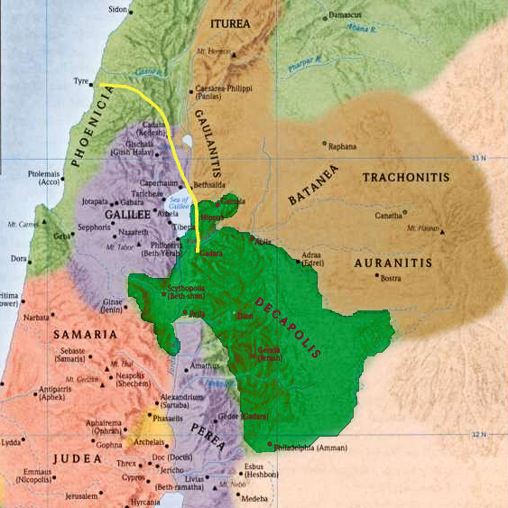
1 Peter 5:6-7

Slide 7
A Man’s Condition (7:31; Matthew 15:29-31)
The setting (Mark 7:31; Matthew 15:29)
The situation (Mark 7:32; Matthew 15:30-31)
30 And large crowds came to Him, bringing with them those who were lame, crippled, blind, mute, and many others, and they laid them down at His feet; and He healed them. 31 So the crowd marveled as they saw the mute speaking, the crippled restored, and the lame walking, and the blind seeing; and they glorified the God of Israel.” (Matthew 15:30-31)
They brought to Him one who was deaf and spoke with difficulty, and they implored Him to lay His hand on him. (Mark 7:32)

Slide 8
The Master’s Cure (7:33-35)
Jesus took him aside (33a)
Jesus touched him (33b)
Jesus looked up to heave (34a)
Jesus sighed and spoke (34b)

Slide 9
Hebrews 2:14-15
“14 Therefore, since the children share in flesh and blood, He Himself likewise also partook of the same, that through death He might render powerless him who had the power of death, that is, the devil, 15 and might free those who through fear of death were subject to slavery all their lives.”

Slide 10
Mark 7:33-35
33 Jesus took him aside from the crowd, by himself, and put His fingers into his ears, and after spitting, He touched his tongue with the saliva; 34 and looking up to heaven with a deep sigh, He said to him, "Ephphatha!" that is, "Be opened!" 35 And his ears were opened, and the impediment of his tongue was removed, and he began speaking plainly.

Slide 11
The multitudes celebration (7:36-37)
Good news is worth sharing (36)
Good news points to God (37)
“He has done all things well…” (echoes Genesis 1:31)
“He makes even the deaf to hear and the mute to speak.” (echoes Isaiah 35:4-6)
4 Say to those with anxious heart, "Take courage, fear not. Behold, your God will come with vengeance; The recompense of God will come, But He will save you." 5 Then the eyes of the blind will be opened And the ears of the deaf will be unstopped. 6 Then the lame will leap like a deer, And the tongue of the mute will shout for joy. For waters will break forth in the wilderness And streams in the Arabah.

Slide 12
The big idea
The compassion of Jesus to save
extends to all people.

Slide 13
Jesus Does All Things Well
Mark 7:31-37
The Authenticity, Affliction and Authority of Jesus Christ, the Son of God

