Slide 1
The Danger of Neglecting God’s Word
7:1-13
The Authenticity, Affliction and Authority of Jesus Christ, the Son of God

Slide 2
Mark 7:1-4
1 The Pharisees and some of the scribes gathered around Him when they had come from Jerusalem, 2 and had seen that some of His disciples were eating their bread with impure hands, that is, unwashed. 3 (For the Pharisees and all the Jews do not eat unless they carefully wash their hands, thus observing the traditions of the elders; 4 and when they come from the market place, they do not eat unless they cleanse themselves; and there are many other things which they have received in order to observe, such as the washing of cups and pitchers and copper pots.)

Slide 3
Mark 7:5-8
5 The Pharisees and the scribes asked Him, "Why do Your disciples not walk according to the tradition of the elders, but eat their bread with impure hands?" 6 And He said to them, "Rightly did Isaiah prophesy of you hypocrites, as it is written: 'THIS PEOPLE HONORS ME WITH THEIR LIPS, BUT THEIR HEART IS FAR AWAY FROM ME. 7 'BUT IN VAIN DO THEY WORSHIP ME, TEACHING AS DOCTRINES THE PRECEPTS OF MEN.' 8 "Neglecting the commandment of God, you hold to the tradition of men."

Slide 4
Mark 7:9-13
9 He was also saying to them, "You are experts at setting aside the commandment of God in order to keep your tradition. 10 "For Moses said, 'HONOR YOUR FATHER AND YOUR MOTHER'; and, 'HE WHO SPEAKS EVIL OF FATHER OR MOTHER, IS TO BE PUT TO DEATH'; 11 but you say, 'If a man says to his father or his mother, whatever I have that would help you is Corban (that is to say, given to God),' 12 you no longer permit him to do anything for his father or his mother; 13 thus invalidating the word of God by your tradition which you have handed down; and you do many things such as that."

Slide 5
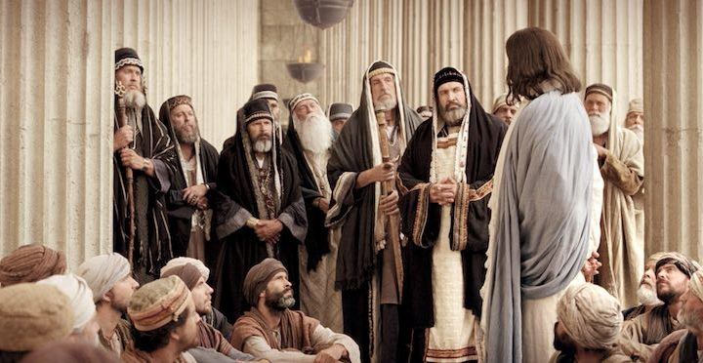
CONFRONTATION

Slide 6
A showdown between tradition and truth
Questions:
“What makes you clean or righteous in the eyes of God?”
“What is the primary authority in your life?”

Slide 7
The “source” and “authority” of the Pharisees – the “spiritual” elites
“the tradition of the elders” (v.3);
“many other things which they have received…” (v.4);
“the tradition of the elders…” (v.5);
“the traditions of men…” (v.8);
“your traditions…” (v.9);
“your tradition which you have handed down…” (v.13).

Slide 8
A showdown between tradition and truth
Three mistakes of man-made religion
The source of man-made religion

Slide 9
2 Peter 1:2-3
“2 Grace and peace be multiplied to you in the knowledge of God and of Jesus our Lord; 3 seeing that His divine power has granted to us everything pertaining to life and godliness, through the true knowledge of Him who called us by His own glory and excellence.”

Slide 10
Frances Ridley Havergal (1836 – 1879) an English Christian poet and hymnwriter. Take My Life and Let it Be and Thy Life for Me are two of her best known hymns.

Slide 11
The Word of God will change your life…
…if you read the Word of God

Slide 12
A showdown between tradition and truth
Three mistakes of man-made religion
The source of man-made religion
The show of man-made religion

Slide 13
Psalm 51:16-17
16 For You do not delight in sacrifice, otherwise I would give it; You are not pleased with burnt offering. 17 The sacrifices of God are a broken spirit; A broken and a contrite heart, O God, You will not despise.

Slide 14
Romans 6:17-18
17 But thanks be to God that though you were slaves of sin, you became obedient from the heart to that form of teaching to which you were committed, 18 and having been freed from sin, you became slaves of righteousness.

Slide 15
Romans 10:910
, 9 that if you confess with your mouth Jesus as Lord, and believe in your heart that God raised Him from the dead, you will be saved; 10 for with the heart a person believes, resulting in righteousness, and with the mouth he confesses, resulting in salvation.

Slide 16
Philippians 2:14-16a
14 Do all things without grumbling or disputing; 15 so that you will prove yourselves to be blameless and innocent, children of God above reproach in the midst of a crooked and perverse generation, among whom you appear as lights in the world, 16 holding fast the word of life…

Slide 17
Ephesians 6:5b-6
…in the sincerity of your heart, as to Christ; 6 not by way of eyeservice, as men-pleasers, but as slaves of Christ, doing the will of God from the heart.

Slide 18
Corban
‘given to God’ – ‘dedicated to God’

Slide 19
Mark 7:11-13
11 but you say, 'If a man says to his father or his mother, whatever I have that would help you is Corban (that is to say, given to God),' 12 YOU no longer permit him to do anything for his father or his mother; 13 thus [YOU ARE] invalidating the word of God by YOUR tradition which YOU have handed down; and YOU do many things such as that."

Slide 20
The Danger of Neglecting God’s Word
7:1-13
The Authenticity, Affliction and Authority of Jesus Christ, the Son of God

