Slide 1
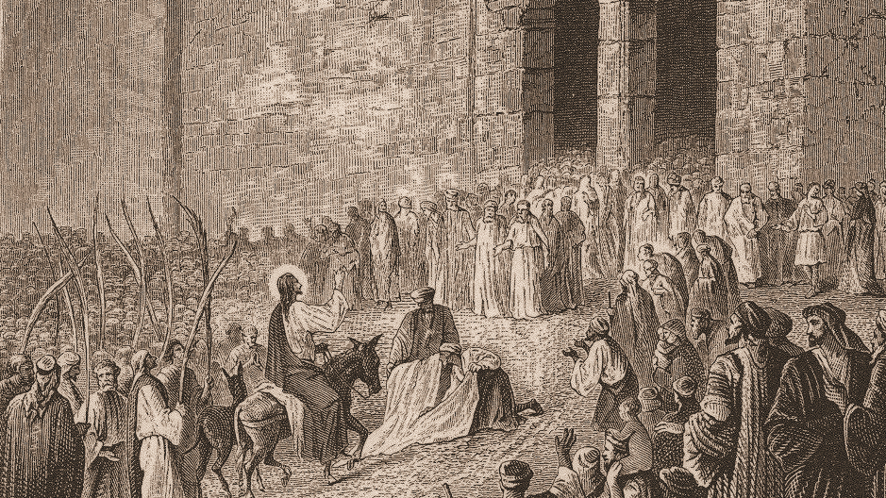
Behold Your King Is Coming To You!
Matthew 21:1-11

Slide 2
Matthew 21:1-5
1 When they had approached Jerusalem and had come to Bethphage, at the Mount of Olives, then Jesus sent two disciples, 2 saying to them, "Go into the village opposite you, and immediately you will find a donkey tied there and a colt with her; untie them and bring them to Me. 3 "If anyone says anything to you, you shall say, 'The Lord has need of them,' and immediately he will send them." 4 This took place to fulfill what was spoken through the prophet: 5 "SAY TO THE DAUGHTER OF ZION, 'BEHOLD YOUR KING IS COMING TO YOU, GENTLE, AND MOUNTED ON A DONKEY, EVEN ON A COLT, THE FOAL OF A BEAST OF BURDEN.'"

Slide 3
Matthew 21:6-11
6 The disciples went and did just as Jesus had instructed them, 7 and brought the donkey and the colt, and laid their coats on them; and He sat on the coats. 8 Most of the crowd spread their coats in the road, and others were cutting branches from the trees and spreading them in the road. 9 The crowds going ahead of Him, and those who followed, were shouting, "Hosanna to the Son of David; BLESSED IS HE WHO COMES IN THE NAME OF THE LORD; Hosanna in the highest!" 10 When He had entered Jerusalem, all the city was stirred, saying, "Who is this?" 11 And the crowds were saying, "This is the prophet Jesus, from Nazareth in Galilee."

Slide 4
The Big Idea
The Triumphal Entry reminds us of who Jesus truly is; the King to be served and the Savior to be adored.

Slide 5
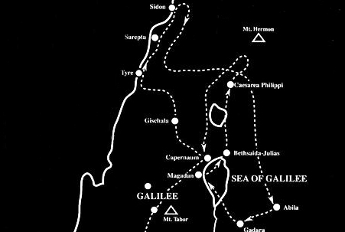
The King’s Path ^{(Matthew 21:1)}
When they had approached Jerusalem and had come to Bethphage, at the Mount of Olives, then Jesus sent two disciples…

Slide 6
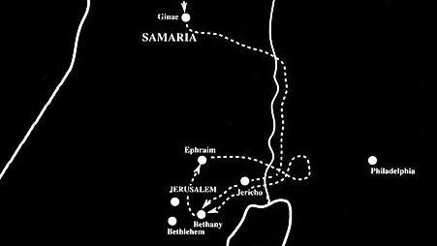

Slide 7
The King’s Preparation ^{(Matthew 21:2-7)}
2 "Go into the village opposite you, and immediately you will find a donkey tied there and a colt with her; untie them and bring them to Me. 3 "If anyone says anything to you, you shall say, 'The Lord has need of them,' and immediately he will send them."

Slide 8
Colossians 1:15-18
15 He is the image of the invisible God, the firstborn of all creation. 16 For by Him all things were created, both in the heavens and on earth, visible and invisible, whether thrones or dominions or rulers or authorities — all things have been created through Him and for Him. 17 He is before all things, and in Him all things hold together. 18 He is also head of the body, the church; and He is the beginning, the firstborn from the dead, so that He Himself will come to have first place in everything.

Slide 9
The King’s Preparation ^{(Matthew 21:2-7)}
4 This took place to fulfill what was spoken through the prophet: 5 "SAY TO THE DAUGHTER OF ZION, 'BEHOLD YOUR KING IS COMING TO YOU, GENTLE, AND MOUNTED ON A DONKEY, EVEN ON A COLT, THE FOAL OF A BEAST OF BURDEN.'
Zechariah 9:9
Rejoice greatly, O daughter of Zion! Shout in triumph, O daughter of Jerusalem! Behold, your king is coming to you; He is just and endowed with salvation, Humble, and mounted on a donkey, Even on a colt, the foal of a donkey.

Slide 10
Revelation 19:11-16
11 And I saw heaven opened, and behold, a white horse, and He who sat on it is called Faithful and True, and in righteousness He judges and wages war. 12 His eyes are a flame of fire, and on His head are many diadems; and He has a name written on Him which no one knows except Himself. 13 He is clothed with a robe dipped in blood, and His name is called The Word of God. 14 And the armies which are in heaven, clothed in fine linen, white and clean, were following Him on white horses. 15 From His mouth comes a sharp sword, so that with it He may strike down the nations, and He will rule them with a rod of iron; and He treads the wine press of the fierce wrath of God, the Almighty. 16 And on His robe and on His thigh He has a name written, “KING OF KINGS, AND LORD OF LORDS.”

Slide 11
Discrepancy?
Matthew 21:2
2 saying to them, "Go into the village opposite you, and immediately you will find a donkey tied there and a colt with her; untie them and bring them to Me.
Mark 11:2
and said to them, "Go into the village opposite you, and immediately as you enter it, you will find a colt tied there, on which no one yet has ever sat; untie it and bring it here.

Slide 12
The King’s Praise ^{(Matthew 21:8-9)}
8 Most of the crowd spread their coats in the road, and others were cutting branches from the trees and spreading them in the road. 9 The crowds going ahead of Him, and those who followed, were shouting, "Hosanna to the Son of David; BLESSED IS HE WHO COMES IN THE NAME OF THE LORD; Hosanna in the highest!"
Luke 19:37-38
37 As soon as He was approaching, near the descent of the Mount of Olives, the whole crowd of the disciples began to praise God joyfully with a loud voice for all the miracles which they had seen, 38 shouting: "BLESSED IS THE KING WHO COMES IN THE NAME OF THE LORD; Peace in heaven and glory in the highest!"

Slide 13
Luke 19:41-44
41 When He approached Jerusalem, He saw the city and wept over it, 42 saying, "If you had known in this day, even you, the things which make for peace! But now they have been hidden from your eyes. 43 "For the days will come upon you when your enemies will throw up a barricade against you, and surround you and hem you in on every side, 44 and they will level you to the ground and your children within you, and they will not leave in you one stone upon another, because you did not recognize the time of your visitation."

Slide 14
The King’s Person ^{(Matthew 21:10-11)}
10 When He had entered Jerusalem, all the city was stirred, saying, "Who is this?" 11 And the crowds were saying, "This is the prophet Jesus, from Nazareth in Galilee."
Titus 3:4-7
4 But when the kindness of God our Savior and His love for mankind appeared, 5 He saved us, not on the basis of deeds which we have done in righteousness, but according to His mercy, by the washing of regeneration and renewing by the Holy Spirit, 6 whom He poured out upon us richly through Jesus Christ our Savior,7 so that being justified by His grace we would be made heirs according to the hope of eternal life.

Slide 15
John 14:23-24
23 "If anyone loves Me, he will keep My word; and My Father will love him, and We will come to him and make Our abode with him. 24 "He who does not love Me does not keep My words; and the word which you hear is not Mine, but the Father's who sent Me.

Slide 16
Matthew 10:33
32 Therefore everyone who confesses Me before men, I will also confess him before My Father who is in heaven. 33 But whoever denies Me before men, I will also deny him before My Father who is in heaven.

Slide 17
Colossians 1:28
We proclaim Him, admonishing every man and teaching every man with all wisdom, so that we may present every man complete in Christ.

Slide 18
Behold Your King Is Coming To You!
Matthew 21:1-11

