Slide 1
The Servant’s Heart of the Servant of the Lord
Mark 6:30-44

Slide 2
Today’s text
Please turn to Mark 6:30-44

Slide 3
Mark 10:45
“For even the Son of Man did not come to be served, but to serve, and to give His life a ransom for many.”

Slide 4
1 John 4:10-11
“10 In this is love, not that we loved God, but that He loved us and sent His Son to be the propitiation for our sins. 11 Beloved, if God so loved us, we also ought to love one another.”

Slide 5
Big Idea
The miracle of the feeding of over 5,000 reveals the servant’s heart of the Servant of the Lord; something we about which we ought to both marvel and also imitate.

Slide 6
The Predicament of Jesus ^{(6:30-32)}

Slide 7
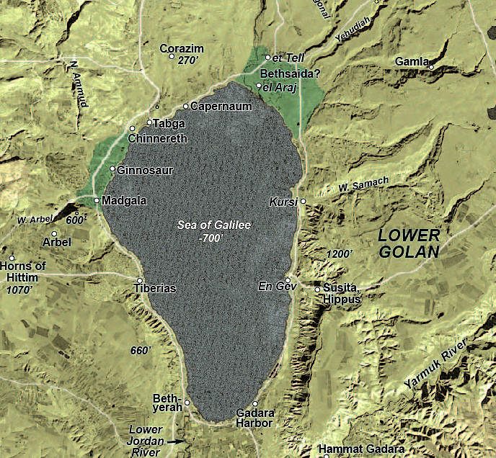

Slide 8
John 10:17-18
“17 For this reason the Father loves Me, because I lay down My life so that I may take it again. 18 No one has taken it away from Me, but I lay it down on My own initiative. I have authority to lay it down, and I have authority to take it up again. This commandment I received from My Father.”

Slide 9
George Whitefield
“We are immortal until our work on earth is done.”

Slide 10
The Predicament of Jesus ^{(6:30-32)}
The Pity of Jesus ^{(6:33-34)}

Slide 11
John 6:2
“And a large crowd followed Him, because they were saw the signs [attesting miracles] which He was performing on those who were sick.”

Slide 12
Pity; compassion
Literally - “being moved in the bowels; or gut.”
Pity/compassion – a sympathetic or kindly sorrow evoked by the suffering, distress, or misfortune of another, often leading one to give relief or aid or to show mercy.

Slide 13
1 Peter 5:6-7
“6 Therefore humble yourselves under the mighty hand of God, that He may exalt you at the proper time, 7 casting all your anxiety on Him, because He cares for you.”

Slide 14
The Predicament of Jesus ^{(6:30-32)}
The Pity of Jesus ^{(6:33-34)}
The proving of the disciples ^{(6:35-38)}

Slide 15
John 6:5-7
5 Therefore Jesus, lifting up His eyes and seeing that a large crowd was coming to Him, said to Philip, "Where are we to buy bread, so that these may eat?" 6 This He was saying to test him, for He Himself knew what He was intending to do. 7 Philip answered Him, "Two hundred denarii worth of bread is not sufficient for them, for everyone to receive a little."

Slide 16
Matthew 14:16
“They do not need to go away; you give them something to eat!”

Slide 17
Spurgeon
“He it was who thought of the way of feeding them, it was a design invented and originated by Himself. His followers had looked at their little store of bread and fish and given up the task as hopeless; but Jesus, altogether unembarrassed, and in no perplexity, had already considered how He would banquet the thousands and make the fainting sing for joy. The Lord of Hosts needed no entreaty to become the Host of hosts of hungry men.”

Slide 18
The Predicament of Jesus ^{(6:30-32)}
The Pity of Jesus ^{(6:33-34)}
The proving of the disciples ^{(6:35-38)}
The provision of Jesus ^{(6:39-44)}

Slide 19
John 6:14-15
14 Therefore when the people saw the sign which He had performed, they said, "This is truly the Prophet who is to come into the world." 15 So Jesus, perceiving that they were intending to come and take Him by force to make Him king, withdrew again to the mountain by Himself alone.

Slide 20
The Predicament of Jesus ^{(6:30-32)}
The Pity of Jesus ^{(6:33-34)}
The proving of the disciples ^{(6:35-38)}
The provision of Jesus ^{(6:39-44)}
The practice of the saints
We need refreshment
The compassion of Jesus is a model for us
We need to trust the Lord for that which is humanly impossible (even for the humanly possible)

Slide 21
Big Idea
The miracle of the feeding of over 5,000 reveals the servant’s heart of the Servant of the Lord; something we about which we ought to both marvel and also imitate.

Slide 22
The Servant’s Heart of the Servant of the Lord
Mark 6:30-44

