Slide 1
An Inequality of Faiths
Mark 6:13-29

Slide 2
Today’s text
Please turn to Mark 6:13--29

Slide 3
Big Idea
Not all “faith” is the same.
What a person believes and to what extent he believes it is not only important but, when it comes to faith in Jesus Christ, is a matter of life and death; or more aptly out; eternal life and eternal damnation.

Slide 4
Question
Do we not generally expect God to be “good” to us - where the word “good” is defined by us?

Slide 5
An inadequate faith (6:14-16)
14 And King Herod heard of it, for His [Jesus’s] name had become well known

Slide 6
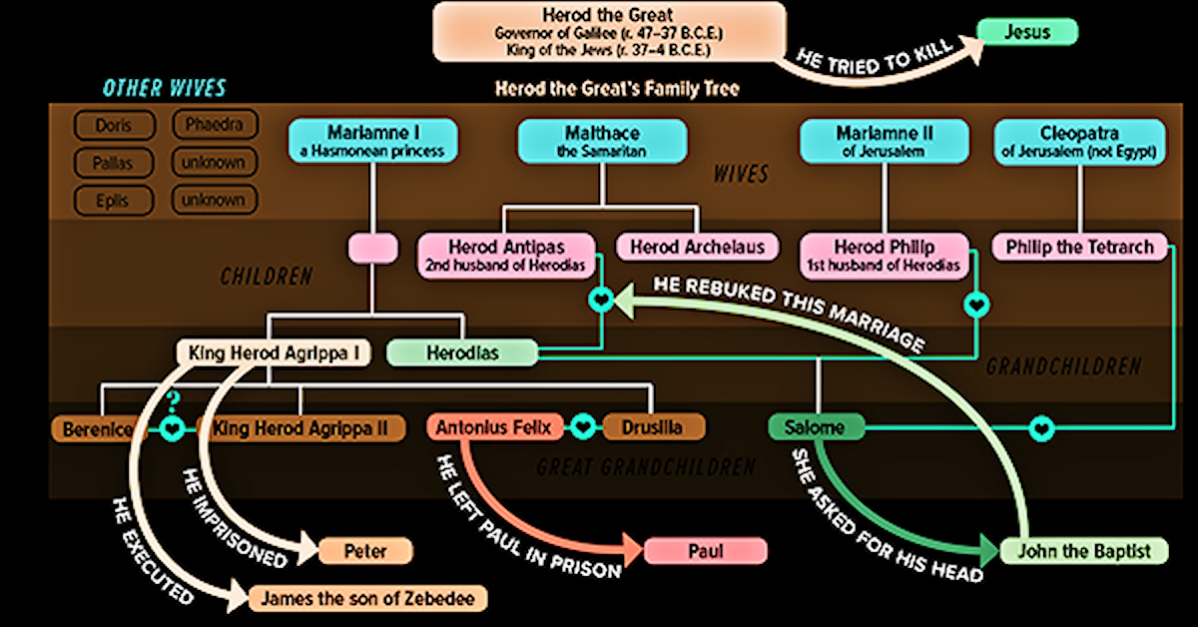

Slide 7
An inadequate faith (6:14-16)
An Immoral faith (6:17-20)
17 For Herod himself had sent and had John arrested and bound in prison on account of Herodias, the wife of his brother Philip, because he had married her.

Slide 9
An inadequate faith (6:14-16)
An Immoral faith (6:17-20)
An Influential faith (6:17-20)
20 for Herod was afraid of John, knowing that he was a righteous and holy man, and he kept him safe.

Slide 10
Charge
Christian ought not to impose their own morality upon others.
The charge is a fallacy:
Everyone promotes their morality (or immorality as the case may be) on others
The charge that Christian are imposing “our” morality is false. Christians are simply proclaiming God’s clearly stated morality.

Slide 11
Proverbs 14:34
“Righteousness exalts a nation,
But sin is a disgrace to any people.”

Slide 12
An inadequate faith (6:14-16)
An Immoral faith (6:17-19)
An Influential faith (6:20)
An intent faith (6:21-28)
An inequality of faiths (6:29)
The faith of Herod vs. the faith of John
The faith of John vs. your own faith

Slide 13
An Inequality of Faiths
Mark 6:13-29

