Slide 1
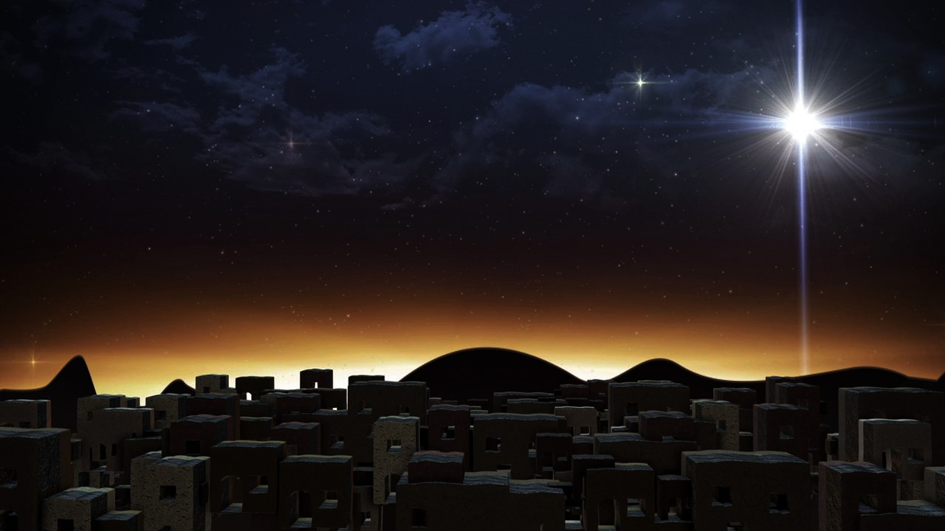
The Glorious Coming
of our Savior King (Part 3)
Luke 2:15-20

Slide 2
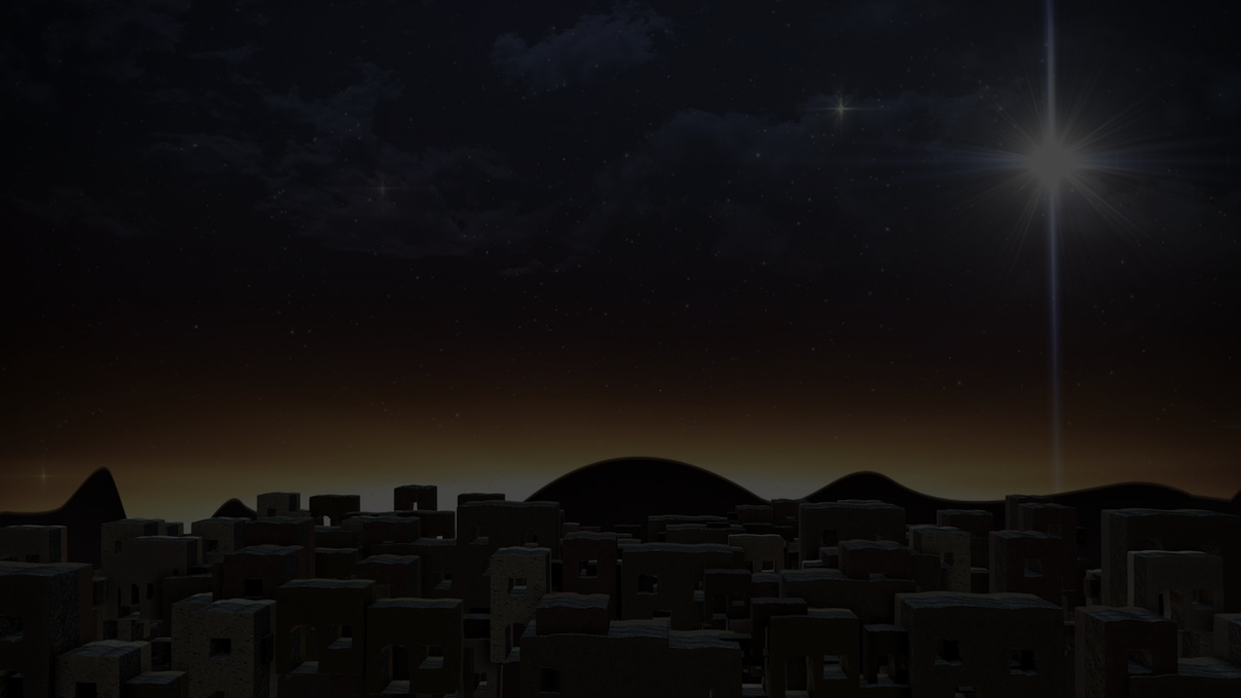
Luke 2:15-20
15 When the angels had gone away from them into heaven, the shepherds began saying to one another, "Let us go straight to Bethlehem then, and see this thing that has happened which the Lord has made known to us." 16 So they came in a hurry and found their way to Mary and Joseph, and the baby as He lay in the manger. 17 When they had seen this, they made known the statement which had been told them about this Child. 18 And all who heard it wondered at the things which were told them by the shepherds. 19 But Mary treasured all these things, pondering them in her heart. 20 The shepherds went back, glorifying and praising God for all that they had heard and seen, just as had been told them.

Slide 3
The proper pondering of Christ begins with investigation (2:15)
When the angels had gone away from them into heaven the shepherds began to say to one another, “Let us go straight to Bethlehem then, and see this thing that has happened which the Lord has made known to us.”

Slide 4
Thought
A person will never come to understand why God sent His Son into the world until he comes to understand the truth about himself.
And what is that truth? That you are a lost and desperate sinner in need of a might Savior.

Slide 5
Recap of point one
The first step in properly pondering the birth of Christ is investigating the matter; considering the account; contemplating the testimony and being in awe of what God has revealed.

Slide 6
The proper pondering of Christ begins with investigation (2:15)
The proper pondering of Christ leads to illumination (2:16)
So they came in a hurry and found their way to Mary and Joseph, and the baby as He lay in the manger.

Slide 7
The proper pondering of Christ begins with investigation ^{(2:15)}
The proper pondering of Christ leads to illumination ^{(2:16)}
The proper pondering of Christ results in sharing information ^{(2:17-19)}
17 When they had seen this, they made known the statement which had been told them about this Child. 18 And all who heard it wondered at the things which were told them by the shepherds. 19 But Mary treasured all these things, pondering them in her heart.

Slide 8
John Owen ⁽¹⁶¹⁶⁻¹⁶⁸³⁾
What eminent gifts are poured out in the days wherein we live! what light is bestowed! what pains in preaching! how is the dispensation of the word multiplied! - yet how little ground is got by it! how few converted! The word hath a free course in preaching, but is not glorified in acceptable obedience. Is it not high time for professors and preachers to look at home, whether the obstacle lie not in ourselves? Do we not fortify the world against the doctrine we profess, by the fruits of it they see in ourselves, and our own ways?

Slide 9
John Own ^{(con’t)}
Do they not say of us, "These are our new lights and professors; proud, selfish, worldly, unrighteous; negligent of the ordinances themselves profess to magnify; useless in their places and generations;—falling into the very same path which they condemn in others"? Perhaps they may deal falsely and maliciously in these things; but is it not high time for us to examine ourselves, lest, abounding in preaching and talking, we have forgot to walk humbly with God;—and so, not glorifying the gospel, have hindered the free course of its work and efficacy?

Slide 10
Thought
Do you know Jesus well enough to see His will and purpose increasingly become your own will and purpose?

Slide 11
The proper pondering of Christ begins with investigation ^{(2:15)}
The proper pondering of Christ leads to illumination ^{(2:16)}
The proper pondering of Christ results in sharing information ^{(2:17-19)}
The proper pondering of Christ ends with inspiration ^{(2:20)}
The shepherds went back, glorifying and praising God for all that they had heard and seen, just as had been told them.

Slide 12
Matthew Henry ⁽¹⁶⁶²⁻¹⁷¹⁴⁾
“They thanked God that they had seen Christ, though in the depth of His humiliation. As afterwards the cross of Christ, so now His manger, was to some foolishness and a stumbling-block, but others saw in it, and admired, and praised, the wisdom of God and the power of God.”

Slide 13
Big Idea:
The coming of the Savior King is intended to change our lives.

Slide 14
The Glorious Coming
of our Savior King (Part 3)
Luke 2:15-20

