Slide 1
The Glorious Coming
of our Savior King (Part 2)
Luke 2:8-14

Slide 2
Luke 2:8-14
8 In the same region there were some shepherds staying out in the fields and keeping watch over their flock by night. 9 And an angel of the Lord suddenly stood before them, and the glory of the Lord shone around them; and they were terribly frightened. 10 But the angel said to them, “Do not be afraid; for behold, I bring you good news of great joy which will be for all the people; 11 for today in the city of David there has been born for you a Savior, who is Christ the Lord. 12 “This will be a sign for you: you will find a baby wrapped in cloths and lying in a manger.” 13 And suddenly there appeared with the angel a multitude of the heavenly host praising God and saying, 14 “Glory to God in the highest, And on earth peace among men with whom He is pleased.”

Slide 3
Last week (Luke 2:1-7)
The Sovereignty of the King (2:1-3)
The Splendor of the King (2:4-5)
The Submissiveness of the Savior (2:6-7)

Slide 4
The Simple Pronouncement (2:8-12)
The angel appeared to the shepherds (8-9)

Slide 5
Ezekiel 34:23-24
23 Then I will set over them one shepherd, My servant David, and he will feed them; he will feed them himself and be their shepherd. 24 And I, the Lord, will be their God, and My servant David will be prince among them; I the Lord have spoken.

Slide 6
The Simple Pronouncement (2:8-12)
The angel appeared to the shepherds (8-9)
The appearing was for common people ^{(see Luke 15:1-2)}
The appearing was a marvelous privilege

Slide 7
The Simple Pronouncement (2:8-12)
The angel announced a message to the shepherds (10-11)
It is “good news” (i.e. “the Gospel”)
It brings “great joy”
It is “for all the people”
It is about “Christ the Lord”
This babe is the Savior
This babe is the Messiah (Christ)
This babe is the Lord

Slide 8
The Simple Pronouncement (2:8-12)
The angel affixed a sign for the shepherds (12)
He will be “wrapped in cloths…”
He will be “lying in a manger”

Slide 9
Luke 9:23
“If anyone wishes to come after Me, he must deny himself, and take up his cross daily and follow Me.”

Slide 10
The Symphonic Praise of a Multitude of Angels (13-14)
Christmas is about the GLORY of God

Slide 11
J.S. Bach (1685-1750)
“All music should have no other end and aim than the glory of God and the soul's refreshment; where this is not remembered there is no real music but only a devilish hub-bub.”

Slide 12
J.S. Bach (1685-1750)
J.J. – Jesus Juva – Jesus help me

Slide 13
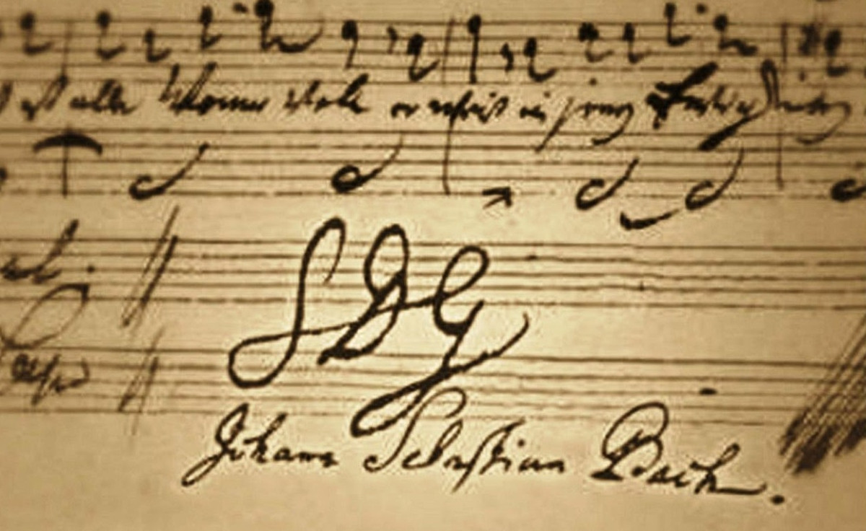
J.S. Bach (1685-1750)
SDG – Soli Deo Gloria – To God alone be the glory!

Slide 14
The Symphonic Praise of a Multitude of Angels (13-14)
Christmas is about the GLORY of God
Christmas is about the GOOD of humanity
The coming of Jesus brings peace to humanity

Slide 15
Applications
How do you “see” Jesus?
As Savior, Christ, and Lord?
How do you treat Jesus?
How do you give glory to God daily?

Slide 16
The Glorious Coming
of our Savior King (Part 2)
Luke 2:8-14

