Slide 1
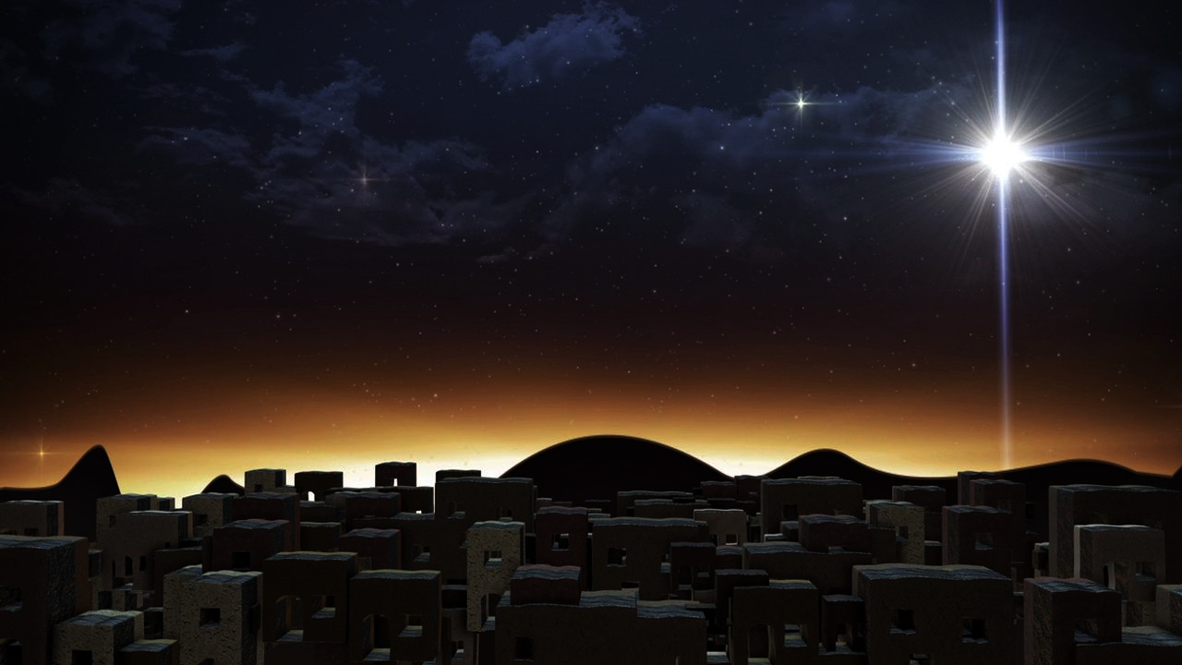
The Glorious Coming
of our Savior King (Part 1)
Luke 2:1-7

Slide 2
Luke 2:1-7
1 Now in those days a decree went out from Caesar Augustus, that a census be taken of all the inhabited earth. 2 This was the first census taken while Quirinius was governor of Syria. 3 And everyone was on his way to register for the census, each to his own city. 4 Joseph also went up from Galilee, from the city of Nazareth, to Judea, to the city of David which is called Bethlehem, because he was of the house and family of David, 5 in order to register along with Mary, who was engaged to him, and was with child. 6 While they were there, the days were completed for her to give birth. 7 And she gave birth to her firstborn son; and she wrapped Him in cloths, and laid Him in a manger, because there was no room for them in the inn.

Slide 3
Big Idea
There are dire and eternal consequences for not knowing the truth concerning the life and work of Jesus.

Slide 4
Luke 1:1-4
1 Inasmuch as many have undertaken to compile an account of the things accomplished among us, 2 just as they were handed down to us by those who from the beginning were eyewitnesses and servants of the word, 3 it seemed fitting for me as well, having investigated everything carefully from the beginning, to write it out for you in consecutive order, most excellent Theophilus; 4 so that you may know the exact truth about the things you have been taught.

Slide 5
The Outline of Luke 2:1-7
The Sovereignty of the King (1-3)
The Splendor of the King (4-5)
The Submissiveness of the Savior (6-7)

Slide 6
The Sovereignty of the King (1-3)
“Now in those days…”
A. Augustus Caesar was in charge…
He issued a decree
Everyone obeyed him
B. Augustus Caesar was NOT REALLY in charge…

Slide 7
Micah 5:2 (710 BC) & Matthew 2:5-6 (8 BC)
But as for you, Bethlehem Ephrathah, too little to be among the clans of Judah, from you One will go forth for Me to be ruler in Israel. His goings forth are from long ago, from the days of eternity. (Micah 5:2)
They said to him, “In Bethlehem of Judea; for this is what has been written by the prophet: 6 'AND YOU, BETHLEHEM, LAND OF JUDAH, ARE BY NO MEANS LEAST AMONG THE LEADERS OF JUDAH; FOR OUT OF YOU SHALL COME FORTH A RULER WHO WILL SHEPHERD MY PEOPLE ISRAEL.’” (Matthew 2:5-6)

Slide 8
Applications
The Lord is in charge of history ^{(see Colossians 1:15-19)}
The Lord is in charge of your life/history ^{(see Acts 17:28)}

Slide 9
The Splendor of the King (4-5)
“Joseph also went up from Galilee, from the city of Nazareth, to Judea, to the city of David which is called Bethlehem, because he was of the house and family of David, 5 in order to register along with Mary, who was engaged to him, and was with child.”
A. Jesus was born into relative obscurity…
B. Jesus was born into royal splendor…

Slide 10
2 Samuel 7:8
“Now therefore, thus you shall say to My servant David, ‘Thus says the Lord of hosts, “I took you from the pasture, from following the sheep, to be ruler over My people Israel.’”

Slide 11
2 Samuel 7:12-16 (Davidic Covenant)
12 "When your days are complete and you lie down with your fathers, I will raise up your descendant after you, who will come forth from you, and I will establish his kingdom. 13 He shall build a house for My name, and I will establish the throne of his kingdom forever. 14 I will be a father to him and he will be a son to Me; when he commits iniquity, I will correct him with the rod of men and the strokes of the sons of men, 15 but My lovingkindness shall not depart from him, as I took it away from Saul, whom I removed from before you. 16 Your house and your kingdom shall endure before Me forever; your throne shall be established forever.”

Slide 12
Applications
Do you believe Jesus is the King?
Is Jesus your King?

Slide 13
The Submissiveness of the Savior (6-7)
“While they were there, the days were completed for her to give birth. 7 And she gave birth to her firstborn son; and she wrapped Him in cloths, and laid Him in a manger, because there was no room for them in the inn.”
A. The Lord Humbled Himself at His Birth
Mary delivered Him
Mary wrapped Him
Mary laid Him in a manger

Slide 14
Philippians 2:5-8
5 Have this attitude in yourselves which was also in Christ Jesus, 6 who, although He existed in the form of God, did not regard equality with God a thing to be grasped, 7 but emptied Himself, taking the form of a bond-servant, and being made in the likeness of men. 8 Being found in appearance as a man, He humbled Himself by becoming obedient to the point of death, even death on a cross.

Slide 15
The Submissiveness of the Savior (6-7)
“While they were there, the days were completed for her to give birth. 7 And she gave birth to her firstborn son; and she wrapped Him in cloths, and laid Him in a manger, because there was no room for them in the inn.”
A. The Lord Humbled Himself at His Birth
B. The Lord expects us to humble ourselves before Him
To be saved, you must humble yourself
To live the Christian life, you must humble yourself (see 1 Peter 5:5b)
To righty appreciate and believe the birth of Christ; you must humble yourself

Slide 16
The Glorious Coming
of our Savior King (Part 1)
Luke 2:1-7

