Slide 1
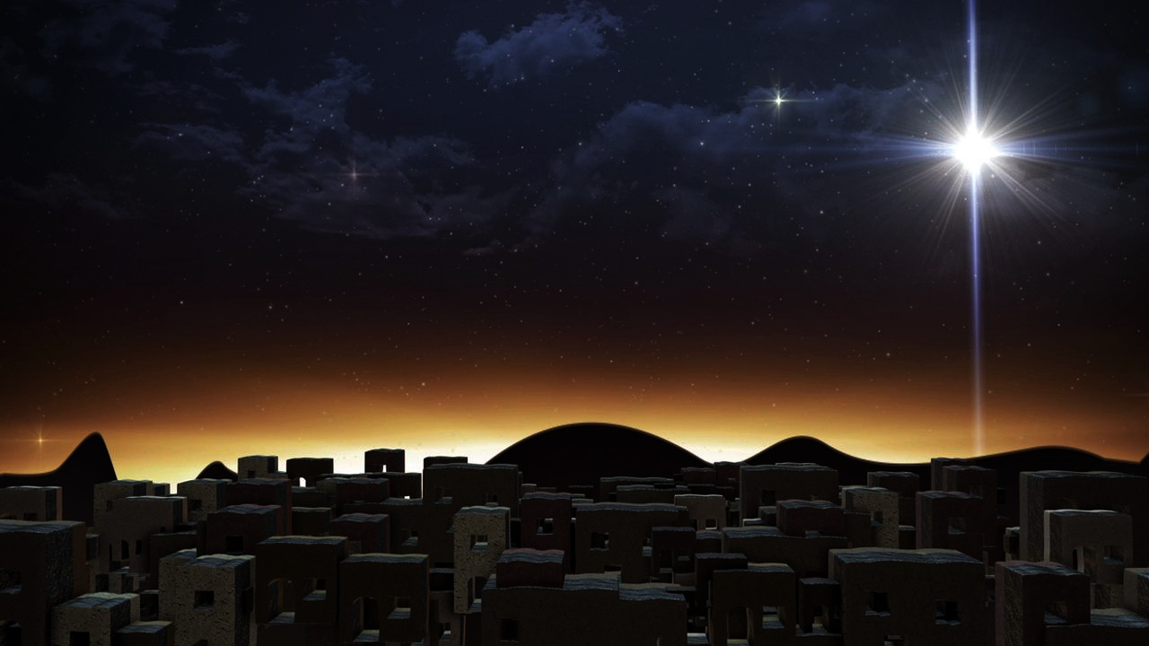
The Wondrous Word
John 1:1 & 14

Slide 2
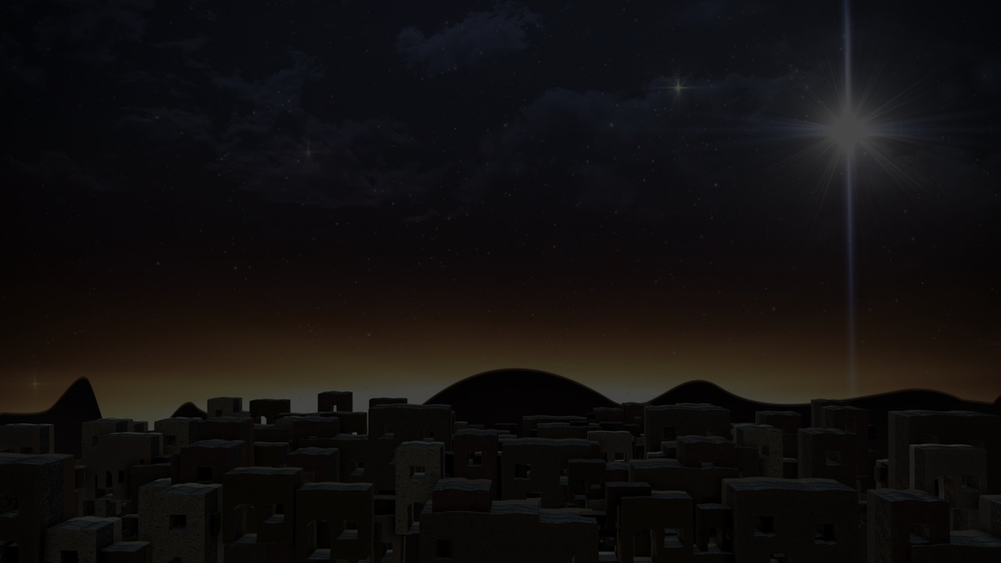
John 1:1-8
“1 In the beginning was the Word, and the Word was with God, and the Word was God. 2 He was in the beginning with God. 3 All things came into being through Him, and apart from Him nothing came into being that has come into being. 4 In Him was life, and the life was the Light of men. 5 The Light shines in the darkness, and the darkness did not comprehend it. 6 There came a man sent from God, whose name was John. 7 He came as a witness, to testify about the Light, so that all might believe through him. 8 He was not the Light, but he came to testify about the Light.

Slide 3
John 1:9-14
9 There was the true Light which, coming into the world, enlightens every man. 10 He was in the world, and the world was made through Him, and the world did not know Him. 11 He came to His own, and those who were His own did not receive Him. 12 But as many as received Him, to them He gave the right to become children of God, even to those who believe in His name, 13 who were born, not of blood nor of the will of the flesh nor of the will of man, but of God. 14 And the Word became flesh, and dwelt among us, and we saw His glory, glory as of the only begotten from the Father, full of grace and truth.”

Slide 4
Big Idea
The Word of God became flesh
in order to save us from our sins.

Slide 5
Hebrews 1:1-2
“1 God, after He spoke long ago to the fathers in the prophets in many portions and in many ways, 2 in these last days has spoken to us in His Son…”

Slide 6
The Word Became Flesh to Save Us From Our Sins.
“In the beginning was the Word, and the Word was with God, and the Word was God --- And the Word became flesh, and dwelt among us…” (John 1:1, 14a)

Slide 7
London Baptist Confession of Faith (1689)
The Son of God, the second person in the Holy Trinity, being very and eternal God, the brightness of the Father's glory, of one substance and equal with Him who made the world, who upholdeth and governeth all things He hath made, did, when the fullness of time was come, take upon Him man's nature…so that two whole, perfect, and distinct natures were inseparably joined together in one person, without conversion, composition, or confusion; which person is very God and very man, yet one Christ, the only mediator between God and man.

Slide 8
The Word – Sent By God
John 4:34 --- “My food is to do the will of Him who sent Me and to accomplish His work.”
John 5:24 --- “Truly, truly, I say to you, he who hears My word, and believes Him who sent Me, has eternal life…”
John 6:38 --- “For I have come down from heaven, not to do My own will, but the will of Him who sent Me.”
John 9:4 --- “We must work the works of Him who sent Me as long as it is day; night is coming when no one can work.”
John 11:42 --- “I knew that You always hear Me; but because of the people standing around I said it, so that they may believe that You sent Me.”

Slide 9
The Word – Sent By God
John 12:45 --- “He who sees Me sees the One who sent Me.”
John 13:20 --- “Truly, truly, I say to you, he who receives whomever I send receives Me; and he who receives Me receives Him who sent Me.”
John 16:5 --- “But now I am going to Him who sent Me; and none of you asks Me, 'Where are You going?'”
John 17:3 --- “This is eternal life, that they may know You, the only true God, and Jesus Christ whom You have sent.”
John 20:21 --- “Peace be with you; as the Father has sent Me, I also send you.”

Slide 10
Matthew 1:20-21
“20 But when he had considered this, behold, an angel of the Lord appeared to him in a dream, saying, “Joseph, son of David, do not be afraid to take Mary as your wife; for the Child who has been conceived in her is of the Holy Spirit. 21 She will bear a Son; and you shall call His name Jesus, for He will save His people from their sins.”

Slide 11
What does it mean to be saved from our sins?
To be saved from our sins is to be delivered from the wrath of God our sins deserve.
“For I am not ashamed of the gospel, for it is the power of God for salvation to everyone who believes…”
(Romans 1:16)
“For the wrath of God is revealed from heaven against all ungodliness and unrighteousness of men who suppress the truth in unrighteousness…”
(Romans 1:18)

Slide 12
Romans 3:24-25
“being justified as a gift by His grace through the redemption which is in Christ Jesus; 25 whom God displayed publicly as a propitiation in His blood through faith.”
“propitiation” means to be saved from the wrath of God by the satisfying and substitutionary work of Christ.

Slide 13
Isaiah 51:17
“Rouse yourself! Rouse yourself! Arise, O Jerusalem, You who have drunk from the Lord's hand the cup of His anger; The chalice of reeling you have drained to the dregs.”

Slide 14
What does it mean to be saved from our sins?
To be saved from our sins is to be delivered from the wrath of God our sins deserve.
To be saved from our sins is to be forgiven our sins.
“When you were dead in your transgressions and the uncircumcision of your flesh, He made you alive together with Him, having forgiven us all our transgressions…”
(Colossians 2:13)

Slide 15
Acts 2:38
“Repent, and each of you be baptized in the name of Jesus Christ for the forgiveness of your sins; and you will receive the gift of the Holy Spirit”
(note also Acts 5:31; 10:43; 13:38; and 26:18)

Slide 16
To be forgiven your sins means…
God no longer holds your sins against you.
“BLESSED IS THE MAN WHOSE SIN THE LORD WILL NOT TAKE INTO ACCOUNT.” (NASB)
“blessed is the man against whom the Lord
will not count his sin.” (ESV)
Romans 4:8

Slide 17
What Christ Bore for Us
“All of us like sheep have gone astray, Each of us has turned to his own way; But the Lord has caused the iniquity of us all To fall on Him.” (Isaiah 53:6)
“and He Himself bore our sins in His body on the cross, so that we might die to sin and live to righteousness; for by His wounds you were healed.” (1 Peter 2:24)

Slide 18
To be forgiven your sins means…
God no longer holds your sins against you.
To experience the mercy and grace of God.
“I, even I, am the one who wipes out your transgressions for My own sake, And I will not remember your sins.”
Isaiah 43:25
“They will not teach again, each man his neighbor and each man his brother, saying, 'Know the Lord,' for they will all know Me, from the least of them to the greatest of them," declares the Lord, "for I will forgive their iniquity, and their sin
I will remember no more.”
Jeremiah 31:34

Slide 19
What does it mean to be saved from our sins?
To be saved from our sins is to be delivered from the wrath of God our sins deserve.
To be saved from our sins is to be forgiven our sins.
To be saved from our sins is to be released from the dominion or power of sin.
“What shall we say then? Are we to continue in sin so that grace may increase?” (Romans 6:1)
“May it never be!” (NASB) “By no means” (ESV); “Absolutely not!” (HCSB); “God forbid!” (KJV); “How shall we who died to sin still live in it?”
Romans 6:2

Slide 20
What does it mean to be saved from our sins?
To be saved from our sins is to be delivered from the wrath of God our sins deserve.
To be saved from our sins is to be forgiven our sins.
To be saved from our sins is to be released from the dominion or power of sin.
To be saved from our sins is to be freed from our old, futile way of life/living.
“18 knowing that you were not redeemed with perishable things like silver or gold from your futile way of life inherited from your forefathers, 19 but with precious blood, as of a lamb unblemished and spotless, the blood of Christ.”
1 Peter 1:18-19

Slide 21
How does the Word that became flesh benefit us?
He is the revelation of God’s love sent for and to us (Romans 5:8)
He is the most precious Person we could ever know [“very God”]
He is the most helpful Person we could ever know [“very Man”]
He is the only Person everyone must receive in order to be saved.
“But as many as received Him, to them He gave the right to become children of God, even to those who believe in His name…”
John 1:12

Slide 22
John 3:36
“He who believes in the Son has eternal life; but he who does not obey the Son will not see life, but the wrath of God abides on him.”

Slide 23
The Wondrous Word
“In the beginning was the Word, and the Word was with God, and the Word was God --- And the Word became flesh, and dwelt among us…”
John 1:1, 14

