Slide 1
Do You Listen to Jesus?
Mark 4:1-20

Slide 2
Mark 4:1-4
1 He began to teach again by the sea. And such a very large crowd gathered to Him that He got into a boat in the sea and sat down; and the whole crowd was by the sea on the land. 2 And He was teaching them many things in parables, and was saying to them in His teaching, 3 “Listen to this! Behold, the sower went out to sow; 4 as he was sowing, some seed fell beside the road, and the birds came and ate it up.

Slide 3
Mark 4:5-7
5 “Other seed fell on the rocky ground where it did not have much soil; and immediately it sprang up because it had no depth of soil. 6 “And after the sun had risen, it was scorched; and because it had no root, it withered away. 7 “Other seed fell among the thorns, and the thorns came up and choked it, and it yielded no crop.

Slide 4
Mark 4:8-9
8 “Other seeds fell into the good soil, and as they grew up and increased, they yielded a crop and produced thirty, sixty, and a hundredfold.” 9 And He was saying, “He who has ears to hear, let him hear.”

Slide 5
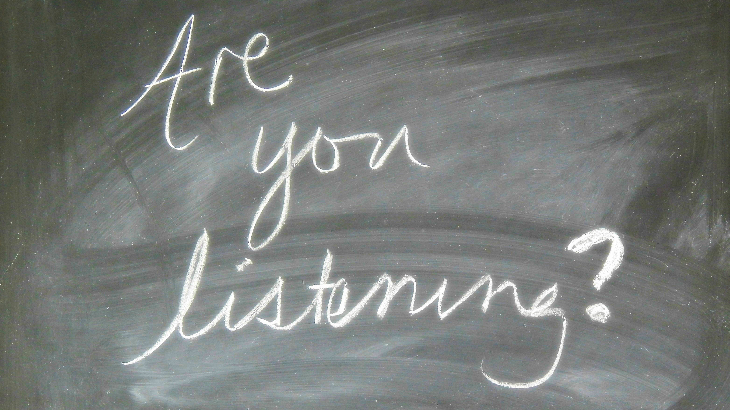
listening

Slide 6
The Parable (4:1-9)
The Purpose of the Parable (4:10-12)

Slide 7
Isaiah 6:9-10
9 And He said, “Go, and tell this people: ‘Keep on listening, but do not perceive; Keep on looking, but do not understand.' 10 Render the hearts of this people insensitive, Their ears dull, And their eyes dim, Lest they see with their eyes, Hear with their ears, Understand with their hearts, And return and be healed.”

Slide 8
The Parable (4:1-9)
The Purpose of the Parable (4:10-12)
The Point of the Parable (4:13-20)
The Roadside soil (4:15)
The Rocky soil (4:16)
The Weedy soil (4:18-19)
The Good soil (4:20)

Slide 9
John 15:4-5
“Abide in Me, and I in you. As the branch cannot bear fruit of itself, unless it abides in the vine, so neither can you, unless you abide in Me. 5 I am the vine, you are the branches; he who abides in Me, and I in him, he bears much fruit; for apart from Me you can do nothing.”

Slide 10
John 14:23
“If anyone loves Me, he will keep My word; and My Father will love him, and We will come to him and make Our abode with him.”

Slide 11
1 Thessalonians 2:13
“For this reason we also constantly thank God that when you received the word of God which you heard from us, you accepted it not as the word of men, but for what it really is, the word of God, which also performs its work in you who believe.”

Slide 12
Amos 8:11
“Behold, days are coming,” declares the Lord God, When I will send a famine on the land, Not a famine for bread or a thirst for water, But rather for hearing the words of the Lord.”

Slide 13
listening

Slide 14
Do You Listen to Jesus?
Mark 4:1-20

