Slide 1
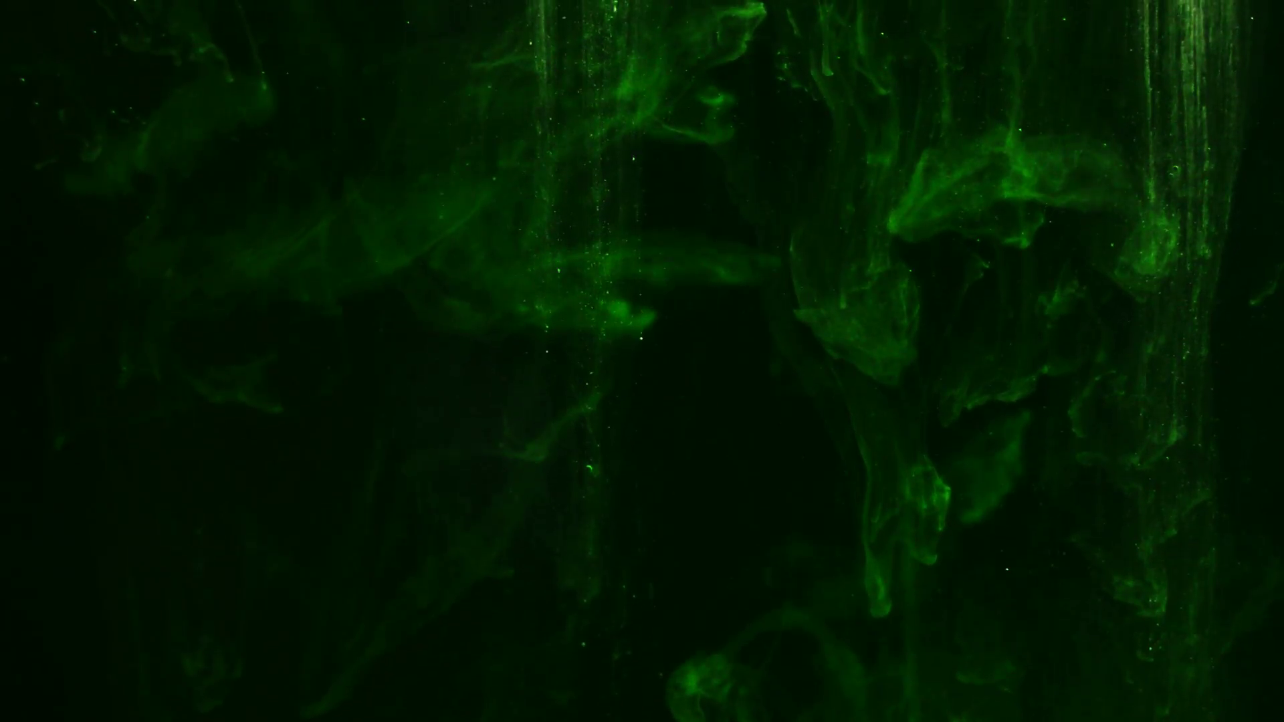
The Greatness of Sin
and the Greater Greatness
of the God Who Saves
Psalm 32

Slide 2
John Newton
“Although my memory's fading,
I remember two things very clearly:
I am a great sinner
and Christ is a great Savior.”

Slide 3
Today’s Sermon Text
Psalm 32

Slide 4
Penitential and Maskil Psalms
The Penitential Psalms: Psalms 6, 32, 38, 51, 102, 130, and 143
Psalms that recognize the corruption and trouble that sin brings into a life
A maskil – “a teaching or instruction”
An intentionally crafted and composed work for the purpose of instructing others
The maskil Psalms: Psalms 32, 44- 45, 52-55, 74, 78, 88-89, 142

Slide 5
Psalm 51:13
“Then I will teach transgressors Your ways, And sinners will be converted to You.”

Slide 6
Saint Augustine
“intelligentia prima est ut te noris peccatorem”
the beginning of knowledge is to know oneself to be a sinner

Slide 7
A Great Pleasure ⁽¹⁻²⁾
1 How blessed is he whose transgression is forgiven, Whose sin is covered! 2 How blessed is the man to whom the Lord does not impute iniquity, And in whose spirit there is no deceit!
Three words for “sin”
“transgression” – a going away; a departure; a rebellion

Slide 8
Alexander Maclaren
“You do not understand the gravity of the most trivial wrong act when you think of it as a sin against the order of Nature, or against the law written on your heart; or as the breach of the constitution of your own nature, or as a crime against your fellows. You have not got to the bottom of the blackness until you see that it is a flat rebellion against God Himself.”

Slide 9
A Great Pleasure ⁽¹⁻²⁾
1 How blessed is he whose transgression is forgiven, Whose sin is covered! 2 How blessed is the man to whom the Lord does not impute iniquity, And in whose spirit there is no deceit!
Three words for “sin”
“transgression” – a going away; a departure; a rebellion
“sin” – missing the mark (see Romans 3:23)
“iniquity” – crooked; twisted; perverse

Slide 10
A Great Pleasure ⁽¹⁻²⁾
1 How blessed is he whose transgression is forgiven, Whose sin is covered! 2 How blessed is the man to whom the Lord does not impute iniquity, And in whose spirit there is no deceit!
Three words for how God deals with “sin”
“transgression” FORGIVEN – removed; lifted off
“sin” COVERED – to cover; protect; and assuage missing the mark (see 1 John 2:1 – “propitiation”)
“iniquity” NOT IMPUTED – not put on or ……charged on one’s account; not counted ……against

Slide 11
Romans 4:5-6
“5 But to the one who does not work, but believes in Him who justifies the ungodly, his faith is credited as righteousness, 6 just as David also speaks of the blessing on the man to whom God credits righteousness apart from works: 7 BLESSED ARE THOSE WHOSE LAWLESS DEEDS HAVE BEEN FORGIVEN, AND WHOSE SINS HAVE BEEN COVERED. 8 BLESSED IS THE MAN WHOSE SIN THE LORD WILL NOT TAKE INTO ACCOUNT.”

Slide 12
A Great Pondering ⁽³⁻⁵⁾
The malignancy of David’s sin (3-4)
3 When I kept silent about my sin, my body wasted away through my groaning all day long. 4 For day and night Your hand was heavy upon me; my vitality was drained away as with the fever heat of summer.
The mercy of God to forgive sin (5)
I acknowledged my sin to You, And my iniquity I did not hide; I said, "I will confess my transgressions to the Lord"; And You forgave the guilt of my sin.

Slide 13
A Great Purpose ⁽⁶⁻⁷⁾
6 Therefore, let everyone who is godly pray to You in a time when You may be found; Surely in a flood of great waters they will not reach him. 7 You are my hiding place; You preserve me from trouble; You surround me with songs of deliverance. Selah.
Today is the day of salvation (6)
“6 Seek the Lord while He may be found; Call upon Him while He is near. 7 Let the wicked forsake his way And the unrighteous man his thoughts; And let him return to the Lord, And He will have compassion on him, And to our God, For He will abundantly pardon” (Isaiah 55:6-7).

Slide 14
2 Corinthians 6:2
“for He [the LORD] says, AT THE ACCEPTABLE TIME I LISTENED TO YOU, AND ON THE DAY OF SALVATION I HELPED YOU. Behold, now is THE ACCEPTABLE TIME, behold, now is THE DAY OF SALVATION…”

Slide 15
Romans 2:4-5
“4 Or do you think lightly of the riches of His kindness and tolerance and patience, not knowing that the kindness of God leads you to repentance? 5 But because of your stubbornness and unrepentant heart you are storing up wrath for yourself in the day of wrath and revelation of the righteous judgment of God…”

Slide 16
A Great Purpose ⁽⁶⁻⁷⁾
6 Therefore, let everyone who is godly pray to You in a time when You may be found; Surely in a flood of great waters they will not reach him. 7 You are my hiding place; You preserve me from trouble; You surround me with songs of deliverance. Selah.
Today is the day of salvation (6)
God is our protector (7)

Slide 17
A Great Promise ⁽⁸⁻¹⁰⁾
8 I will instruct you and teach you in the way which you should go; I will counsel you with My eye upon you. 9 Do not be as the horse or as the mule which have no understanding, Whose trappings include bit and bridle to hold them in check, Otherwise they will not come near to you. 10 Many are the sorrows of the wicked, But he who trusts in the Lord, lovingkindness shall surround him. 11 Be glad in the Lord and rejoice, you righteous ones; And shout for joy, all you who are upright in heart.

Slide 18
1 John 1:6-9
6 If we say that we have fellowship with Him and yet walk in the darkness, we lie and do not practice the truth; 7 but if we walk in the Light as He Himself is in the Light, we have fellowship with one another, and the blood of Jesus His Son cleanses us from all sin. 8 If we say that we have no sin, we are deceiving ourselves and the truth is not in us. 9 If we confess our sins, He is faithful and righteous to forgive us our sins and to cleanse us from all unrighteousness.

Slide 19
The Greatness of Sin
and the Greater Greatness
of the God Who Saves
Psalm 32

