Slide 1
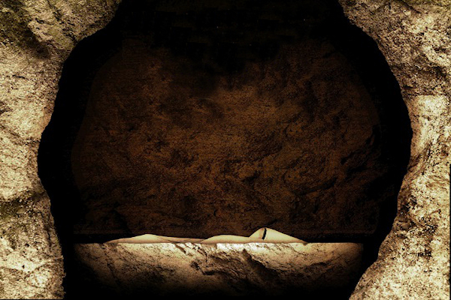
See What A Morning
Luke 24:1-12; 36-48

Slide 2
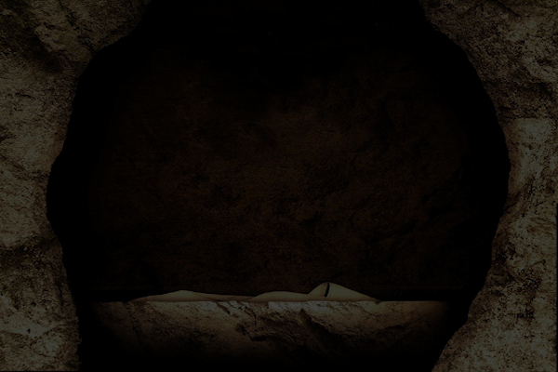
Sermon Text
Luke 24:1-12; 36-48

Slide 3
Old German Hymn
“When morning gilds the skies,
my heart awakening cries,
may Jesus Christ be praised.”

Slide 4
See What A Morning
See what a morning;
gloriously bright;
with the dawning of hope
in Jerusalem;
folded the grave clothes,
tomb filled with light
as the angels announce,
‘Christ is risen!’

Slide 5
Spurgeon
"Come, see the place where the Lord lay," with joy and gladness. He does not lie there now. Weep, when ye see the tomb of Christ, but rejoice because it is empty. Thy sin slew him, but his divinity raised him up. Thy guilt hath murdered him, but his righteousness hath restored him. Oh! he hath burst the bonds of death, he hath ungirt the cerements of the tomb, and hath come out more than conqueror, crushing death beneath his feet. Rejoice, O Christian, for he is not there—He is risen.

Slide 6
Thought
The cross without the resurrection is meaningless;
and the resurrection without the cross is powerless

Slide 7
Big Idea
In light of the resurrection, people are called to reflect on the power of sin; to remember what Jesus has promised; to realize who Jesus is; and to reach the world with this good news that Jesus is risen just as He said.

Slide 8
In light of the resurrection, we are…
Reflect on the power of sin (24:1)
But on the first day of the week, at early dawn, they came to the tomb bringing the spices which they had prepared.

Slide 9
1 Corinthians 15:12-15
“12 Now if Christ is preached, that He has been raised from the dead, how do some among you say that there is no resurrection of the dead? 13 But if there is no resurrection of the dead, not even Christ has been raised; 14 and if Christ has not been raised, then our preaching is vain, your faith also is vain. 15 Moreover we are even found to be false witnesses of God, because we testified against God that He raised Christ, whom He did not raise, if in fact the dead are not raised.”

Slide 10
1 Corinthians 15:16-19
“16 For if the dead are not raised, not even Christ has been raised; 17 and if Christ has not been raised, your faith is worthless; you are still in your sins.18 Then those also who have fallen asleep in Christ have perished. 19 If we have hoped in Christ in this life only, we are of all men most to be pitied.”

Slide 11
In light of the resurrection, we are…
Remember what the Lord has promised (24:2-12)
The witness of the stone rolled away and an empty tomb (24:2-3)
The witness of the Angelic messengers (24:4-7)

Slide 12
Luke 9:22; 44
22 “The Son of Man must suffer many things and be rejected by the elders and chief priests and scribes, and be killed and be raised up on the third day…”
44 “Let these words sink into your ears; for the Son of Man is going to be delivered into the hands of men.”

Slide 13
Luke 18:31-33
“31 Behold, we are going up to Jerusalem, and all things which are written through the prophets about the Son of Man will be accomplished. 32 For He will be handed over to the Gentiles, and will be mocked and mistreated and spit upon, 33 and after they have scourged Him, they will kill Him; and the third day He will rise again.”

Slide 14
John 14:1-3
“1 Do not let your heart be troubled; believe in God, believe also in Me. 2 In My Father's house are many dwelling places; if it were not so, I would have told you; for I go to prepare a place for you. 3 If I go and prepare a place for you, I will come again and receive you to Myself, that where I am, there you may be also.”

Slide 15
1 Peter 3-7
3 Blessed be the God and Father of our Lord Jesus Christ, who according to His great mercy has caused us to be born again to a living hope through the resurrection of Jesus Christ from the dead. . . 6 In this you greatly rejoice, even though now for a little while, if necessary, you have been distressed by various trials, 7 so that the proof of your faith, being more precious than gold which is perishable, even though tested by fire, may be found to result in praise and glory and honor at the revelation of Jesus Christ…

Slide 16
John 3:36
“He who believes in the Son has eternal life; but he who does not obey the Son will not see life, but the wrath of God abides on him.”

Slide 17
John 14:13-14
13 Everyone who drinks of this water will thirst again; 14 but whoever drinks of the water that I will give him shall never thirst; but the water that I will give him will become in him a well of water springing up to eternal life.”

Slide 18
In light of the resurrection, we are…
Remember what the Lord has promised (24:2-12)
The witness of the stone rolled away and an empty tomb (24:2-3)
The witness of the Angelic messengers (24:4-7)
The witness of the women (24:8-12)

Slide 19
In light of the resurrection, we are…
Realize who Jesus is (24:36-43)
An extraordinary event
An extraordinary joy

Slide 20
John 20:29
“Because you have seen Me, have you believed? Blessed are they who did not see, and yet believed.”

Slide 21
In light of the resurrection, we are…
Realize who Jesus is (24:36-43)
An extraordinary event
An extraordinary joy
An extraordinary response

Slide 22
In light of the resurrection, we are…
Reach the world with the gospel (24:44-48)
“You are witnesses of these things.”

Slide 23
The Blessings of the Resurrection
Because we believe Jesus is risen; we are saved by the grace of God.
Because we believe Jesus is risen, the guilt of our sins removed forever.
Because we believe Jesus is risen, we enter Heaven when we exit this world.
Because we believe Jesus is risen, we are never alone in this world; He has given His Holy Spirit.
Because we believe Jesus is risen, the grave has no power over us.

Slide 24
The Blessings of the Resurrection
Because we believe Jesus is risen, eternal life is not simply a future prospect; it is also our present possession.
Because we believe Jesus is risen, we have hope, help and a heavenly home awaiting us.
Because we believe Jesus is risen, we know we are made alive with Christ.
Because we believe Jesus is risen, we have our names written in the Lamb's book of life.

Slide 25
The Blessings of the Resurrection
Because we believe Jesus is risen, God is our Father.
Because we believe Jesus is risen, sin has no more dominion over us.
Because we believe Jesus is risen, we are saved to the uttermost.

Slide 26
Questions
Have you come to realize that Jesus is alive and that He is both what and who you need to have meaning and purpose; eternal meaning and purpose in life?
Have you come to realize what will happen to you if you die without Jesus?
Have you come to realize there is no other way to the Father than through the Lord Jesus Christ?
Have you come to realize that Jesus loves enough to die for your sins?

Slide 27
Questions
Have you come to realize that Jesus died for you?
Have you come to realize that His death is meaningless to you if you fail to come before Him in repentance and humility, confessing your sins to Him?
Have you come to realize that you may come to him in repentance and humility, confessing your sins to Him this morning and be forever saved?

Slide 28
See What A Morning
Luke 24:1-12; 36-48

