Slide 1
The Gospel of Mark
The Action, Authenticity, and Authority of Jesus Christ, the Son of God
The Next Witnesses
The Obedience of Christ –
The Temptations by the Devil –
The Service of Angels
Mark 1:12-13 (Part 1)

Slide 2
Mark 1:9-11
9 In those days Jesus came from Nazareth in Galilee and was baptized by John in the Jordan. 10 Immediately coming up out of the water, He saw the heavens opening, and the Spirit like a dove descending upon Him; 11 and a voice came out of the heavens: “You are My beloved Son, in You I am well-pleased.”

Slide 3
Mark 1:12-13
12 Immediately the Spirit impelled Him to go out into the wilderness. 13 And He was in the wilderness forty days being tempted by Satan; and He was with the wild beasts, and the angels were ministering to Him.

Slide 4
Mark’s Purpose
“The beginning of the gospel of Jesus Christ, the Son of God.” – Mark 1:1
Mark is determined that his readers know by way of testimony and evidence that Jesus Christ is the Son of God who became the Son of Man so that He might give His life as a ransom for many, for all who believe.

Slide 5
Preliminary Thoughts
A theology of Jesus’ temptation
Contained within these two verses are the great and theological themes of our redemption, of our justification and even of our sanctification.
A contrast between the First Adam and the Second Adam
What the First Adam lost for us in the Garden, Jesus, the Second Adam, will win back for us in the wilderness.

Slide 6
Preliminary Thoughts
The necessity of the temptation
Jesus had to be tempted in order to save us.
Everything Jesus said and did was both redemptive (pressing toward our salvation) and doxological (pointing to the glory of God).
What the temptation of Christ reveals to us.
Jesus had to live for us before He could die for us.

Slide 7
1 John 3:8
“the one who practices sin is of the devil; for the devil has sinned from the beginning. The Son of God appeared for this purpose, to destroy the works of the devil.”

Slide 8
Hebrews 2:14-15
“14 Therefore, since the children share in flesh and blood, He Himself likewise also partook of the same, that through death He might render powerless him who had the power of death, that is, the devil, 15 and might free those who through fear of death were subject to slavery all their lives.”

Slide 9
The Big Idea
Jesus, as a Spirit-filled man is:
compelled by the Spirit;
confronted by Satan;
considerate of His surroundings; and
comforted by angels
in fulfilling His role as
the Son of God.

Slide 10
I. Jesus is compelled by the Spirit ^{(1:12)}
Immediately the Spirit impelled Him to go out into the wilderness.
The Contrasts
The baptism of Christ serves as a confirmation of Jesus as the Son of God. The temptation of Jesus serves as a confirmation of Jesus as the Lord’s suffering servant.
The baptism serves as the beginning of Jesus’ pursuit of the kingdom of God that will come via a bloody cross. The temptation of Jesus shows us Satan offering Jesus a crossless path to secure the kingdoms of the earth.

Slide 11
I. Jesus is compelled by the Spirit ^{(1:12)}
Immediately the Spirit impelled Him to go out into the wilderness.
The Contrasts
The baptism of Jesus reveals Heaven’s approval while the temptation of Jesus reveals Hell’s attack.
The baptism of Jesus was the affirmation of God the Father that Jesus is the Son of God; the temptation of Jesus was an attempt of Satan to lure the Son of God to sin.
The baptism of Jesus was a public coronation; while the temptation of Jesus was a private confrontation.

Slide 12
I. Jesus is compelled by the Spirit ^{(1:12)}
Immediately the Spirit impelled Him to go out into the wilderness.
The Compelling
“impelled” - mean “to thrust out; to cast out; to drive out; to expel; to force out; to compel.”
The Spirit is strongly influencing, controlling, leading, guiding, compelling Jesus out into a barren wasteland.

Slide 13
Being Spirit-filled
To be filled with the Spirit of God NEVER meant that Jesus ceased to draw upon His humanity; rather to be filled with the Spirit meant that Jesus sought to constantly have His humanity live by and in accordance with the Spirit of God.

Slide 14
Matthew 4:1
“Then Jesus was led up by the Spirit into the wilderness to be tempted by the devil.”

Slide 15
I. Jesus is compelled by the Spirit ^{(1:12)}
Immediately the Spirit impelled Him to go out into the wilderness.
The Conditions
Tempted; tested, tried, enticed by the Devil.
Did not return to Jerusalem or Galilee.
Driven into the wilderness; alone, no food.

Slide 16
II. Jesus is confronted by Satan ^{(1:13a)}
And He was in the wilderness forty days being tempted by Satan;
This confrontation is designed to prove that Jesus is the Son of God
This confrontation is emphasizing that the temptation of Jesus by Satan is not the end of Jesus’ suffering and temptation, but rather simply the beginning of it (see Luke 4:13).
This confrontation has a remarkable contender – Satan.

Slide 17
Truths about Temptation
Being holy does not equate to not being tempted.
Temptation is not sin.

Slide 18
John 14:30-31
“30 I will not speak much more with you, for the ruler of the world is coming, and he has nothing in Me; 31 but so that the world may know that I love the Father, I do exactly as the Father commanded Me. Get up, let us go from here.”

Slide 19
Romans 8:5-8
“5 For those who are according to the flesh set their minds on the things of the flesh, but those who are according to the Spirit, the things of the Spirit. 6 For the mind set on the flesh is death, but the mind set on the Spirit is life and peace, 7 because the mind set on the flesh is hostile toward God; for it does not subject itself to the law of God, for it is not even able to do so, 8 and those who are in the flesh cannot please God.”

Slide 20
Truths about Temptation
Being holy does not equate to not being tempted.
Temptation is not sin.
God graciously limits the scope and severity of our temptations.

Slide 21
1 Corinthians 10:13
“No temptation has overtaken you but such as is common to man; and God is faithful, who will not allow you to be tempted beyond what you are able, but with the temptation will provide the way of escape also, so that you will be able to endure it.”

Slide 22
Jesus – Tempted and Tried
Thus, to be tempted by Satan, as Jesus was, and to come out on the other side, as Jesus did, demonstrates again that He truly is the Son of God who has become the Son of Man so that as the Lord’s Suffering Servant He might also prove Himself to be our Savior.

Slide 23
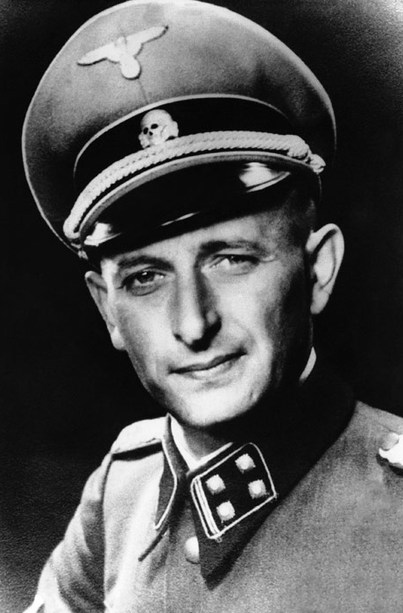
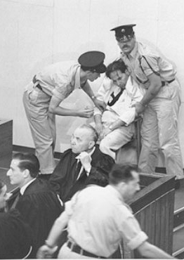
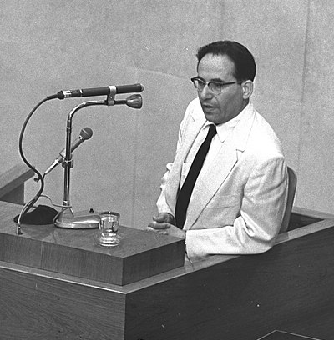
Yehiel Dinur
Adolph Eichmann

Slide 24
Filled with the Spirit for Ministry
To be filled with the Spirit means that we, like Jesus, seek to constantly have our humanity live by and in accordance with the Spirit of God.

Slide 25
The Gospel of Mark
The Action, Authenticity, and Authority of Jesus Christ, the Son of God
The Next Witnesses
The Obedience of Christ –
The Temptations by the Devil –
The Service of Angels
Mark 1:12-13 (Part 1)

