Slide 1
Philippians 2:5-8
(Part 3)

Slide 2
Philippians 2:5-8
5 Have this attitude in yourselves which was also in Christ Jesus, 6 who, although He existed in the form of God, did not regard equality with God a thing to be grasped, 7 but emptied Himself, taking the form of a bond-servant, and being made in the likeness of men. 8 Being found in appearance as a man, He humbled Himself by becoming obedient to the point of death, even death on a cross.

Slide 3
Chalcedonian Formula or Definition (451 AD)
We, then, following the holy Fathers, all with one consent, teach men to confess one and the same Son, our Lord Jesus Christ, the same, perfect in Godhead and also perfect in manhood; truly God and truly man, of a reasonable [rational] soul and body; consubstantial [co-essential] with the Father according to the Godhead, and consubstantial with us according to the Manhood; in all things like unto us, without sin; begotten before all ages of the Father according to the Godhead, and in these latter days, for us and for our salvation, born of the Virgin Mary, the Mother of God [theotokos – “the God bearer”], according to the Manhood;

Slide 4
Chalcedonian Formula or Definition (451 AD)
one and the same Christ, Son, Lord, only begotten, to be acknowledged in two natures, inconfusedly, unchangeably, indivisibly, inseparably; the distinction of natures being by no means taken away by the union, but rather the property of each nature being preserved, and concurring in one Person and one Subsistence, not parted or divided into two persons, but one and the same Son, and only begotten, God the Word, the Lord Jesus Christ; as the prophets from the beginning [have declared] concerning Him, and the Lord Jesus Christ Himself has taught us, and the Creed of the holy Fathers has handed down to us.

Slide 5
What was it like? What did He go through?
What did God go through; and what was the purpose of His becoming flesh, being made in the likeness of men and taking on the appearance as a man?

Slide 6
Psalm 113:1-6
1 Praise the Lord! Praise, O servants of the Lord, Praise the name of the Lord. 2 Blessed be the name of the Lord From this time forth and forever. 3 From the rising of the sun to its setting The name of the Lord is to be praised. 4 The Lord is high above all nations; His glory is above the heavens. 5 Who is like the Lord our God, Who is enthroned on high, 6 Who humbles Himself to behold The things that are in heaven and in the earth?

Slide 7
Philippians 2:5-8
5 Have this attitude in yourselves which was also in Christ Jesus, 6 who, although He existed in the form of God, did not regard equality with God a thing to be grasped, 7 but emptied Himself, taking the form of a bond-servant, and being made in the likeness of men. 8 Being found in appearance as a man, He humbled Himself by becoming obedient to the point of death, even death on a cross.

Slide 8
Mark 10:45
“For even the Son of Man did not come to be served, but to serve, and to give His life a ransom for many.”

Slide 9
The Big Question
“How humble are you and are you willing to make yourself in order to serve others?”

Slide 10
Christ gave up His right to dwell as God in full glory.
who, although He existed in the form of God, did not regard equality with God a thing to be grasped… (v. 6)
“who, although He [that is Christ] exists, has always existed and will always exist possessing the very nature of God, did not regard being just as much God as the Godhead and thus properly acknowledged as such something He could not give up for a time in order to save His people…”

Slide 11
II. Christ “emptied Himself”
who, although He existed in the form of God, did not regard equality with God a thing to be grasped, 7 but emptied Himself…(vs. 6-7a)
“kenoo” (kenosis) – “to empty, to make empty; or to make of no effect; to neutralize.”
“If anyone wishes to come after Me, he must deny himself, and take up his cross daily and follow Me.” (Luke 9:23)

Slide 12
III. Christ took up “servanthood”
…taking the form of a bond-servant…(7b)
more literally, “took upon Himself, once and for all time, the very nature of a slave.”
“For even the Son of Man did not come to be served, but to serve, and to give His life a ransom for many.”
(Mark 10:45)

Slide 13
Christ was made in the likeness of men and fashioned as a man.
…and being made in the likeness of men. 8 Being found in appearance as a man… (7c-8a)
Even though Christ was both 100% man and 100% God, it was His humanity that was on display during His incarnation, not His deity.

Slide 14
Christ humbled Himself through obedience to the point of death
…He humbled Himself by becoming obedient to the point of death, even death on a cross.(vs. 8b)
A. Christ humbled Himself
B. Christ became obedient
“Do you not believe that I am in the Father, and the Father is in Me? The words that I say to you I do not speak on My own initiative, but the Father abiding in Me does His works.” (John 14:10)

Slide 15
Hebrews 10:5-7
5 Therefore, when He comes into the world, He says, ‘SACRIFICE AND OFFERING YOU HAVE NOT DESIRED, BUT A BODY YOU HAVE PREPARED FOR ME; 6 IN WHOLE BURNT OFFERINGS AND sacrifices FOR SIN YOU HAVE TAKEN NO PLEASURE.’ 7 THEN I SAID, ‘BEHOLD, I HAVE COME (IN THE SCROLL OF THE BOOK IT IS WRITTEN OF ME) TO DO YOUR WILL, O GOD.’

Slide 16
Hebrews 10:8-10
8 After saying above, ‘SACRIFICES AND OFFERINGS AND WHOLE BURNT OFFERINGS AND sacrifices FOR SIN YOU HAVE NOT DESIRED, NOR HAVE YOU TAKEN PLEASURE in them’ (which are offered according to the Law), 9 then He said, ‘BEHOLD, I HAVE COME TO DO YOUR WILL.’ He takes away the first in order to establish the second. 10 By this will we have been sanctified through the offering of the body of Jesus Christ once for all.

Slide 17
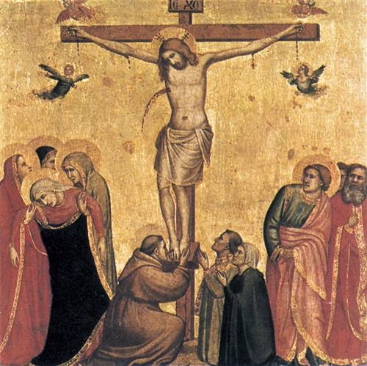
The Crucifixion of Jesus

Slide 18
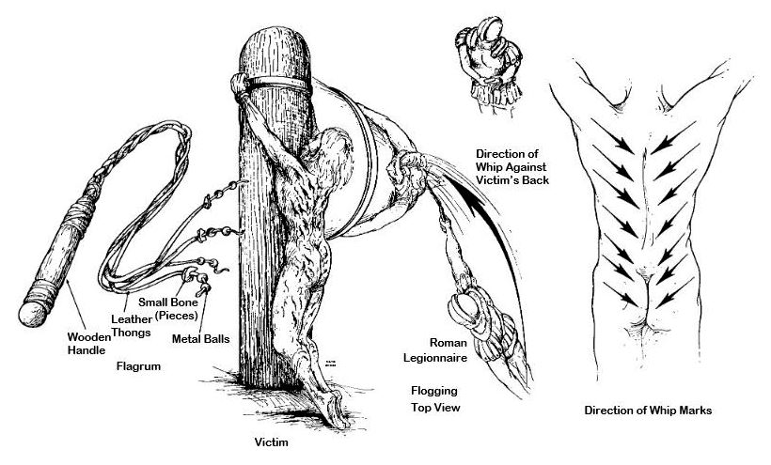

Slide 19
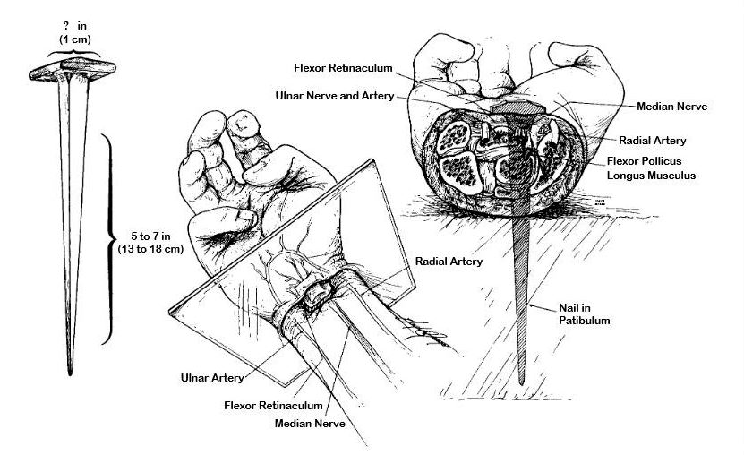

Slide 20
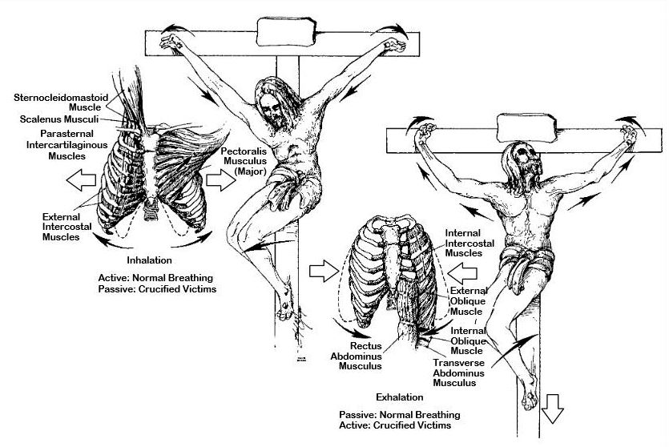

Slide 21
Hebrews 2:14
“Therefore, since the children share in flesh and blood, He Himself likewise also partook of the same, that through death He might render powerless him who had the power of death, that is, the devil…”

Slide 22
Deuteronomy 21:22-23
“22 If a man has committed a sin worthy of death and he is put to death, and you hang him on a tree, 23 his corpse shall not hang all night on the tree, but you shall surely bury him on the same day (for he who is hanged is accursed of God), so that you do not defile your land which the Lord your God gives you as an inheritance.”

Slide 23
Mark 15:33-34
“33 When the sixth hour [noon] came, darkness fell over the whole land until the ninth hour. 34 At the ninth hour Jesus cried out with a loud voice, "ELOI, ELOI, LAMA SABACHTHANI?" which is translated, "MY GOD, MY GOD, WHY HAVE YOU FORSAKEN ME?"

Slide 24
Isaiah 53:5-6
“5 But He was pierced through for our transgressions, He was crushed for our iniquities; the chastening for our well-being fell upon Him, And by His scourging we are healed. 6 All of us like sheep have gone astray, each of us has turned to his own way; But the Lord has caused the iniquity of us all to fall on Him.”

Slide 25
Philippians 2:5
“Have this attitude in yourselves which was also in Christ Jesus…”

Slide 26
Three Considerations
What was the last thing you gave up to sacrificially serve another person? How often do you practice sacrificial giving like this?
Do you often find yourself defending your rights to be respected or served or do you use those times when others might be taking advantage of you as an opportunity to serve them?
How much time do you actually devote to thinking about the person and work of Christ? How much on a daily basis? How much of Christ’s attitude are you actually familiar with so that you can imitate Him?

Slide 27
Philippians 2:5-8
(Part 4)

