Slide 1
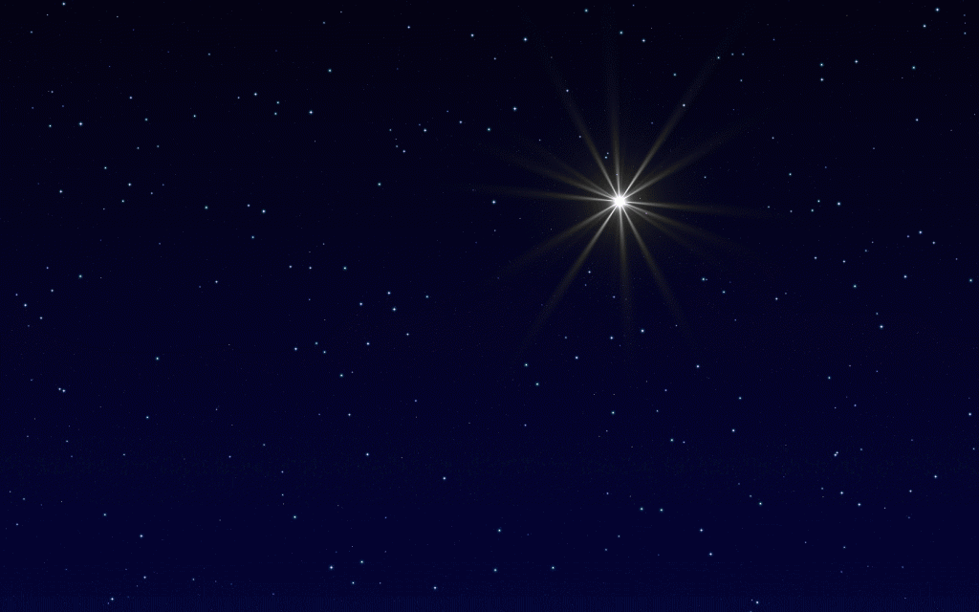
The Star of Christmas
Matthew 2:1-12

Slide 2
Hebrew Prophecy
For a Hebrew prophecy to be regarded as true, it must come to pass with 100% accuracy.
There are some 60 prophecies concerning the first coming of Christ.

Slide 3
Two Prophecies Concerning Christ’s Coming
“But as for you, Bethlehem Ephrathah, Too little to be among the clans of Judah, From you One will go forth for Me to be ruler in Israel. His goings forth are from long ago, From the days of eternity” (Micah 5:2)
725 B.C. indicating the birthplace of Messiah
“Therefore the LORD Himself will give you a sign: Behold, a virgin will be with child and bear a son, and she will call His name Immanuel” (Isaiah 7:14).
735 B.C. indicating the virgin birth of Messiah

Slide 4
What are the odds?
For a single person to fulfill just eight (8) of the 60 prophecies concerning the first coming of Messiah is 1 in 10²¹
(1 in 1,000,000,000,000,000,000,000 – a sextillion)
That number visualized: “First, blanket the entire Earth land mass with silver dollars 120 feet high. Second, specially mark one of those dollars and randomly bury it. Third, ask a person to travel the Earth and select the marked dollar, while blindfolded, from the trillions of other dollars.”

Slide 5
What are the odds?
For a single person to fulfill all the prophecies concerning the first coming of Messiah with 100% accuracy as see in Jesus Christ?
One mathematician’s estimate of those impossible odds is “one chance in a trillion, trillion, trillion, trillion, trillion, trillion, trillion, trillion, trillion, trillion, trillion, trillion, trillion.”
In other words, this is not humanly possible. It must be supernaturally accomplished.

Slide 6
The Star of Christmas
Matthew 2:1-12

Slide 7
The Star of Christmas
I. Consider the skies
“3 When I consider Your heavens, the work of Your fingers, The moon and the stars, which You have ordained; 4 What is man that You take thought of him, And the son of man that You care for him?” (Psalm 8:3-4).
“In the beginning, God created the heavens and the earth.” (Genesis 1:1)
God gave us the stars to give light on the earth and to “be for signs and for seasons and for days and years” (Genesis 1:14).

Slide 8
Matthew 2:2
“Where is He who has been born King of the Jews? For we saw His star in the east and have come to worship Him.”

Slide 9
Psalm 19:1
“The heavens are telling of the glory of God; And their expanse is declaring the work of His hands.”

Slide 10
The Star of Christmas
II. Consider the Scriptures
“Where is He who has been born King of the Jews? For we saw His star in the east and have come to worship Him.” (Matthew 2:2)
“A star shall come forth from Jacob, a scepter shall rise from Israel, and shall crush through the forehead of Moab, and tear down all the sons of Sheth.” (Numbers 24:17 – 1445 B.C.)
“The scepter shall not depart from Judah, Nor the ruler's staff from between his feet, Until Shiloh comes, And to him shall be the obedience of the peoples.” (Genesis 49:10 – 1700 B.C.)

Slide 11
Isaiah 9:1-2 (735 B.C.)
“1 But there will be no more gloom for her who was in anguish; in earlier times He treated the land of Zebulun and the land of Naphtali with contempt, but later on He shall make it glorious, by the way of the sea, on the other side of Jordan, Galilee of the Gentiles. 2 The people who walk in darkness will see a great light; those who live in a dark land, the light will shine on them.”

Slide 12
Isaiah 60:1-3 (725 B.C.)
“Arise, shine; for your light has come, And the glory of the LORD has risen upon you. 2 For behold, darkness will cover the earth and deep darkness the peoples; But the LORD will rise upon you and His glory will appear upon you. 3 Nations will come to your light, and kings to the brightness of your rising.”

Slide 13
The Star of Christmas
III. Consider the sign
A. The moment of the star
7 Then Herod secretly called the magi and determined from them the exact time the star appeared. 8 And he sent them to Bethlehem and said, “Go and search carefully for the Child; and when you have found Him, report to me, so that I too may come and worship Him.” (Matthew 2:7-8)
Herod “sent and slew all the male children who were in Bethlehem and all its vicinity, from two years old and under, according to the time which he had determined from the magi.” (Matthew 2:16)

Slide 14
The Star of Christmas
III. Consider the sign
B. The movement of the star
After hearing the king, they went their way; and the star, which they had seen in the east, went on before them until it came and stood over the place where the Child was. (Matthew 2:9)
Was the “star” a comet?
Was the “star” planetary alignment?
Was the “star” a supernova (exploding star)?
Was the “star” a visible manifestation of the glory of God?

Slide 15
Matthew 2:9-11
“9 …the star, which they had seen in the east, went on before them until it came and stood over the place where the Child was. 10 When they saw the star, they rejoiced exceedingly with great joy. 11 After coming into the house they saw the Child with Mary His mother; and they fell to the ground and worshiped Him. Then, opening their treasures, they presented to Him gifts of gold, frankincense, and myrrh.”

Slide 16
The Star of Christmas
IV. Consider the significance
The purpose of the star was to capture the attention of the Magi and inspire them to seek the Christ Child.
The purpose of the star is to point people to Christ.

Slide 17
The Star of Christmas
Application
“Where is He who has been born King of the Jews? For we saw His star in the east and have come to worship Him.” (v. 2)
And he sent them to Bethlehem and said, “Go and search carefully for the Child; and when you have found Him, report to me, so that I too may come and worship Him.” (v. 8)
After coming into the house they saw the Child with Mary His mother; and they fell to the ground and worshiped Him. Then, opening their treasures, they presented to Him gifts of gold, frankincense, and myrrh. (v. 11)

Slide 18
The Star of Christmas
Application
Who Jesus is…
Jesus is the fulfillment of all the Old Testament prophecies, something no one else can claim or even come close to. He is the ruler who came out of Israel and the obedience of the nations belongs to Him.
The Gospel of Matthew begins with foreigners from a distant land coming to worship Christ…it ends with Jesus’ commission to the church to “Go therefore and make disciples of all the nations, baptizing them in the name of the Father and the Son and the Holy Spirit…” (Matthew 28:19)

Slide 19
The Star of Christmas
Matthew 2:1-12

