Slide 1
Philippians 2:5-8
(Part 3)

Slide 2
Philippians 2:5-8
5 Have this attitude in yourselves which was also in Christ Jesus, 6 who, although He existed in the form of God, did not regard equality with God a thing to be grasped, 7 but emptied Himself, taking the form of a bond-servant, and being made in the likeness of men. 8 Being found in appearance as a man, He humbled Himself by becoming obedient to the point of death, even death on a cross.

Slide 3
Big Idea
In Christ we have someone who can empathize with us and comfort us because He is like us.

Slide 4
The Challenge
Have this attitude in yourselves which was also in Christ Jesus… (2:5)

Slide 5
I. Christ gave up His rights as God
who, although He existed in the form of God, did not regard equality with God a thing to be grasped… (v. 6)
“who, although He [that is Christ] exists, has always existed and will always exist possessing the very nature of God, did not regard being just as much God as the Godhead and thus properly acknowledged as such something He could not give up for a time in order to save His people…” (paraphrase commentary – ekg)

Slide 6
II. Christ “emptied Himself”
who, although He existed in the form of God, did not regard equality with God a thing to be grasped, 7 but emptied Himself…(vs. 6-7a)
“kenoo” (kenosis) – “to empty, to make empty; or to make of no effect; to neutralize.”

Slide 7
Luke 9:23; 22:42; 9:24
“If anyone wishes to come after Me, he must deny himself, and take up his cross daily and follow Me.” (Luke 9:23)
“Not My will, but Yours be done” (Luke 22:42).
“For whoever wishes to save his life will lose it, but whoever loses his life for My sake, he is the one who will save it” (Luke 9:24)

Slide 8
III. Christ took up servanthood
6 who, although He existed in the form of God, did not regard equality with God a thing to be grasped, 7 but emptied Himself, taking the form of a bond-servant…
Literally - “took upon Himself, once and for all time, the very nature of a slave.”
Mark 10:45
For even the Son of Man did not come to be served, but to serve, and to give His life a ransom for many.

Slide 9
The servant attitude of Christ
John 5:19
Truly, truly, I say to you, the Son can do nothing of Himself, unless it is something He sees the Father doing; for whatever the Father does, these things the Son also does in like manner.

Slide 10
The servant attitude of Christ
John 5:30
I can do nothing on My own initiative. As I hear, I judge; and My judgment is just, because I do not seek My own will, but the will of Him who sent Me.

Slide 11
The servant attitude of Christ
John 6:38
For I have come down from heaven, not to do My own will, but the will of Him who sent Me.

Slide 12
The servant attitude of Christ
John 8:28
When you lift up the Son of Man, then you will know that I am He, and I do nothing on My own initiative, but I speak these things as the Father taught Me.

Slide 13
The servant attitude of Christ
John 12:49-50
49 For I did not speak on My own initiative, but the Father Himself who sent Me has given Me a commandment as to what to say and what to speak. 50 I know that His commandment is eternal life; therefore the things I speak, I speak just as the Father has told Me.

Slide 14
The servant attitude of Christ
John 6:39-40
39 This is the will of Him who sent Me [this is why Jesus gave up His rights and emptied Himself, taking up the form of a slave], that of all that He has given Me I lose nothing, but raise it up on the last day. 40 For this is the will of My Father, that everyone who beholds the Son and believes in Him will have eternal life, and I Myself will raise him up on the last day.

Slide 15
IV. Christ was made in the likeness of men
and being made in the likeness of men… (v.7c)
The word “likeness” speaks of that which is like something else; that bears the same resemblance. Therefore, homoiomati may be translated as “likeness, similar, image, or copy.”

Slide 16
Romans 5:12-15
“12 Therefore, just as through one man sin entered into the world, and death through sin, and so death spread to all men, because all sinned — 13 for until the Law sin was in the world, but sin is not imputed when there is no law.14 Nevertheless death reigned from Adam [a man] until Moses [a man], even over those who had not sinned in the likeness of the offense of Adam [a man], who is a type of Him who was to come. 15 But the free gift is not like the transgression. For if by the transgression of the one the many died, much more did the grace of God and the gift by the grace of the one Man, Jesus Christ, abound to the many.

Slide 17
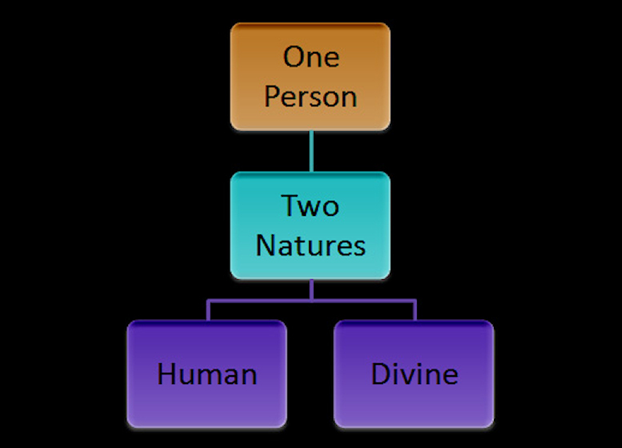
“Hypostatic Union” of Christ

Slide 18
Hebrews 4:15
“For we do not have a high priest who cannot sympathize with our weaknesses, but One who has been tempted in all things as we are, yet without sin.”

Slide 19
Hebrews 11:11-14
“11 Every priest stands daily ministering and offering time after time the same sacrifices, which can never take away sins; 12 but He, having offered one sacrifice for sins for all time, SAT DOWN AT THE RIGHT HAND OF GOD, 13 waiting from that time onward UNTIL HIS ENEMIES BE MADE A FOOTSTOOL FOR HIS FEET. 14 For by one offering He has perfected for all time those who are sanctified.”

Slide 20
Hebrews 4:14-15
“14 Therefore, since we have a great high priest who has passed through the heavens, Jesus the Son of God, let us hold fast our confession.15 For we do not have a high priest who cannot sympathize with our weaknesses, but One who has been tempted in all things as we are, yet without sin. 16 Therefore let us draw near with confidence to the throne of grace, so that we may receive mercy and find grace to help in time of need.”

Slide 21
Big Idea
In Christ we have someone who can empathize with us and comfort us because He is like us.

Slide 22
Philippians 2:5-8
(Part 3)

