Slide 1
1 Timothy 1:15-17

Slide 2
1 Timothy 1:15-17
15 It is a trustworthy statement, deserving full acceptance, that Christ Jesus came into the world to save sinners, among whom I am foremost of all. 16 Yet for this reason I found mercy, so that in me as the foremost, Jesus Christ might demonstrate His perfect patience as an example for those who would believe in Him for eternal life. 17 Now to the King eternal, immortal, invisible, the only God, be honor and glory forever and ever. Amen.

Slide 3
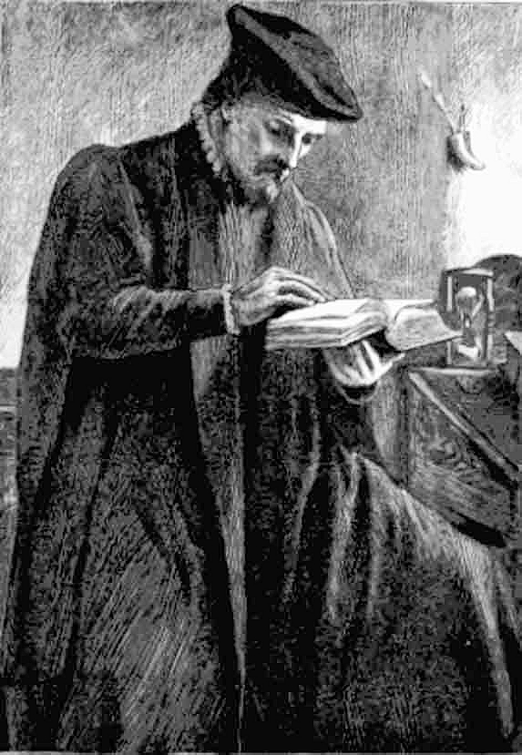
Changed by God’s Word
Thomas Bilney
(1495-1531)

Slide 4
1 Timothy 1:15
A literal reading:
“faithful the word and of all embracement worthy; that Christ Jesus came into the world sinners to save, among first am I.”

Slide 5
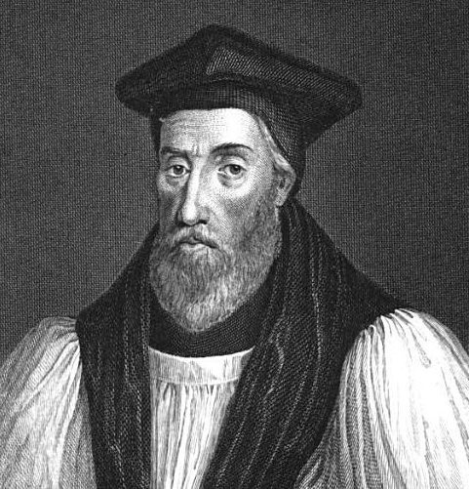
Changed by God’s Word
Thomas Bilney
(1495-1531)
Hugh Latimer
(1487-1555)

Slide 6
Big Idea for 1 Timothy 1:15a,b
“Every faithful follower of Jesus Christ professes his confidence in the sure reliability and self-evident reasonableness of the gospel message.”

Slide 7
Six descriptions of the Gospel
from 1 Timothy 1:15-17
The Gospel is…
trustworthy,
axiomatic (reasonable/acceptable),
Salvific (deals with salvation),
personal,
sanctifying, and
doxological (to God’s glory).

Slide 8
Six descriptions of the Gospel
from 1 Timothy 1:15-17
The gospel is trustworthy ^{(15a)}
It is a trustworthy statement…

Slide 9
The Word of God Converts people…
For Thomas Bilney we saw that it was by 1 Timothy 1:15-17 that his disbelief was turned to belief.
For Augustine – Romans 13:13-14 “Let us behave properly as in the day, not in carousing and drunkenness, not in sexual promiscuity and sensuality, not in strife and jealousy. 14 But put on the Lord Jesus Christ, and make no provision for the flesh in regard to its lusts.” This passage changed Augustine

Slide 10
The Word of God Converts people…
For Martin Luther - Romans 1:16-17, “16 For I am not ashamed of the gospel, for it is the power of God for salvation to everyone who believes, to the Jew first and also to the Greek. 17 For in it the righteousness of God is revealed from faith to faith; as it is written, ‘BUT THE RIGHTEOUS man SHALL LIVE BY FAITH.’”
For Matthew Henry - Psalm 51:17, “The sacrifices of God are a broken spirit; A broken and a contrite heart, O God, You will not despise.”

Slide 11
The Word of God Converts people…
For William Cowper - Romans 3:25, “[Christ] whom God displayed publicly as a propitiation in His blood through faith. This was to demonstrate His righteousness, because in the forbearance of God He passed over the sins previously committed…”
For J.C. Ryle - Ephesians 2:8, “For by grace you have been saved through faith; and that not of yourselves, it is the gift of God…”

Slide 12
The Word of God Converts people…
For C.H. Spurgeon - Isaiah 45:22, “Look unto me, and be ye saved, all the ends of the earth: for I am God, and there is none else.”
For Ed Godfrey - Romans 10:9-10, “9 that if you confess with your mouth Jesus as Lord, and believe in your heart that God raised Him from the dead, you will be saved; 10 for with the heart a person believes, resulting in righteousness, and with the mouth he confesses, resulting in salvation.”

Slide 13
Six descriptions of the Gospel
from 1 Timothy 1:15-17
The gospel is trustworthy ^{(15a)}
It is a trustworthy statement…
The gospel is axiomatic ^{(15b)}
deserving of full acceptance…
“and all acceptance worthy (axios)”
“axious” (Greek) – fully worthy, acceptable, reasonable, embraceable, self-evident
Axiom (English) - a self-evident truth that requires no proof; a proposition assumed without proof for the sake of studying the consequences that follow it.

Slide 14
Romans 1:18-20
“18 For the wrath of God is revealed from heaven against all ungodliness and unrighteousness of men who suppress the truth in unrighteousness, 19 because that which is known about God is evident within them; for God made it evident to them. 20 For since the creation of the world His invisible attributes, His eternal power and divine nature, have been clearly seen, being understood through what has been made, so that they are without excuse.”

Slide 15
1 Timothy 2:3-4
“3 This is good and acceptable in the sight of God our Savior, 4 who desires all men to be saved and to come to the knowledge of the truth.”

Slide 16
Amos 8:11-12
“11 Behold, days are coming," declares the Lord God, "When I will send a famine on the land, Not a famine for bread or a thirst for water, But rather for hearing the words of the Lord. 12 People will stagger from sea to sea And from the north even to the east; They will go to and fro to seek the word of the Lord, But they will not find it.”

Slide 17
1 Timothy 1:15 paraphrase
“Now I offer you a trustworthy statement, one reasonable, embraceable truth for all peoples to receive.”

Slide 18
2 Corinthians 5:20
“Therefore, we are ambassadors for Christ, as though God were making an appeal through us; we beg you on behalf of Christ, be reconciled to God.”

Slide 19
1 Timothy 1:15
It is a trustworthy statement, deserving full acceptance, that Christ Jesus came into the world to save sinners, among whom I am foremost of all.

Slide 20
Big Idea for 1 Timothy 1:15a,b
“Every faithful follower of Jesus Christ professes his confidence in the sure reliability and self-evident reasonableness of the gospel message.”

Slide 21
1 Timothy 1:15-17

