Slide 2
Ephesians 6:21-22
21 But that you also may know about my circumstances, how I am doing, Tychicus, the beloved brother and faithful minister in the Lord, will make everything known to you. 22 I have sent him to you for this very purpose, so that you may know about us, and that he may comfort your hearts.

Slide 3
Ephesians 6:21-24
Ephesians 6:21-22 - Paul’s desire to inform the Ephesians about his own circumstances along with a description, a portrait, of the man who will carry this information; a man by the name of Tychicus. Paul is seeking their education.
Ephesians 6:23-24, we have a declaration of Paul’s desire for the saints’ inspiration – that they experience the greatness and the fullness of God in their endeavors to follow Christ. Paul is seeking their edification.

Slide 4
Big Idea of Ephesians 6:21-22
In the portrait of Tychicus we find that a practicing believer has fellowship with spiritual leaders; loves, is faithful, serves, and comforts the saints.

Slide 5
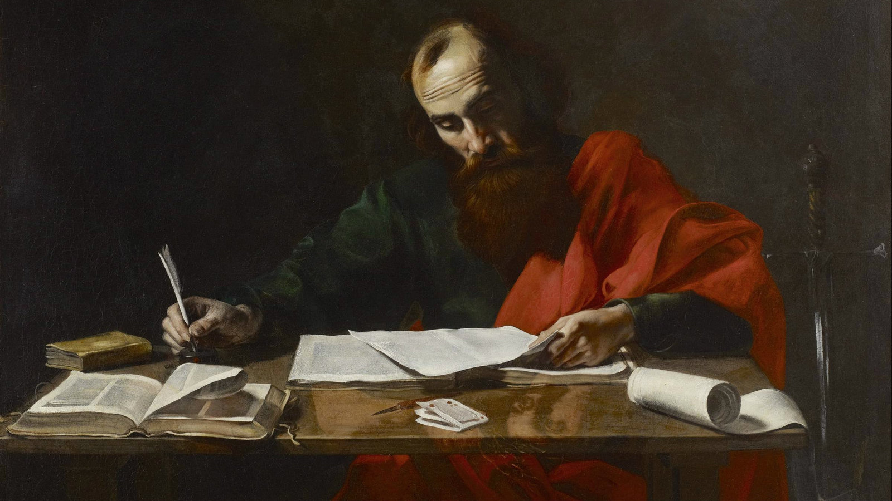
“The Portrait of a Practicing Believer”
or
“What Paul expects of Believers”
If Paul were to describe your portrait, would he say similar things about you?

Slide 6
John 13:34-35
“34 A new commandment I give to you, that you love one another, even as I have loved you, that you also love one another. 35 By this all men will know that you are My disciples, if you have love for one another.”

Slide 7
Lucian – Greek Writer – 150AD
“It is incredible to see the fervor with which the people of that religion help each other in their wants. They spare nothing. Their first legislator [Jesus] has put it into their heads that they are all brethren.”

Slide 8
The practicing believer fellowships with spiritual leaders ^{(6:21)}
But that you also may know about my circumstances, how I am doing, Tychicus…will make everything known to you.
Tychicus (“fortunate”):
A trustworthy friend of Paul and servant of the Lord from Asia Minor.
Accompanied Paul on part of his third missionary journey (Acts 20:4 – 55 AD).
He was one of the men who helped take the collection to Jerusalem.
He made his way back to Rome to be with Paul in his first imprisonment. (60 AD)

Slide 9
The practicing believer fellowships with spiritual leaders ^{(6:21)}
But that you also may know about my circumstances, how I am doing, Tychicus…will make everything known to you.
Sent back to Asia Minor with the letters to the Ephesians, the Colossians, and to a man named Philemon around 60 AD.
Tychicus would escort the runaway slave, Onesimus, back to his owner, Philemon.
Around 62 AD, sent to relieve Titus on the island of Crete (Titus 3:12).
With Paul during his second imprisonment. (66 AD)
Sent to back to Ephesus to relieve Timothy so he could try to get to Paul before his execution (68 AD)

Slide 10
1 Thessalonians 5:12-13
“12 But we request of you, brethren, that you appreciate* those who diligently labor among you, and have charge over you in the Lord and give you instruction, 13 and that you esteem them very highly in love because of their work.”
*appreciate – “to know; be keenly aware of; to get it” – same Greek words as in Ephesians 6:21

Slide 11
The practicing believer loves and is loved by the saints ^{(6:21b)}
Tychicus, the beloved brother…
“7 As to all my affairs, Tychicus, our beloved* brother and faithful servant and fellow bond-servant in the Lord, will bring you information. 8 For I have sent him to you for this very purpose, that you may know about our circumstances and that he may encourage your hearts…” (Colossians 4:7-8)
*beloved – deeply loved; highly appreciated; most honored

Slide 12
The practicing believer is faithful to the saints ^{(6:21c)}
Tychicus…faithful minister in the Lord…
“faithful” - being trustworthy; dependable, reliable; someone that you can entrust with things of value.
Being a person of your word
Doing what is assigned to you with full integrity
Practicing the fruit of the Spirit (Galatians 5:22 - faithfulness)

Slide 13
The practicing believer serves the saints ^{(6:21d)}
Tychicus, the faithful minister in the Lord…
“minister” (diakonos – servant) – true of every practicing believer.
Fellow bond-servant (Colossians 4:8) – literally “slave” of Christ.
“Well done, good and faithful slave. You were faithful with a few things, I will put you in charge of many things; enter into the joy of your master” (Matthew 25:21).

Slide 14
The practicing believer comforts the saints ^{(6:22)}
I have sent him to you for this very purpose, so that you may know about us, and that he may comfort* your hearts.
*comfort – “parakaleo” also means to encourage; aid; counsel.
To be an encourager/comforter means that you seek to help people see circumstances from God’s perspective, which always brings hope and encouragement

Slide 15
Big Idea of Ephesians 6:21-22
In the portrait of Tychicus we find that a practicing believer has fellowship with spiritual leaders; loves, is faithful, serves, and comforts the saints.

