Slide 2
Ephesians 6:18-20
18 With all prayer and petition pray at all times in the Spirit, and with this in view, be on the alert with all perseverance and petition for all the saints, 19 and pray on my behalf, that utterance may be given to me in the opening of my mouth, to make known with boldness the mystery of the gospel, 20 for which I am an ambassador in chains; that in proclaiming it I may speak boldly, as I ought to speak.

Slide 3
The Prayerless Poem
I knelt to pray but not for long, I had too much to do. I had to hurry and get to work
For bills would soon be due. So I knelt and said a hurried prayer,
And jumped up off my knees. My Christian duty was now done
My soul could rest at ease…

Slide 4
The Prayerless Poem
All day long I had no time
To spread a word of cheer. No time to speak of Christ to friends,
They'd laugh at me I'd fear. “No time, no time, too much to do,”
That was my constant cry, No time to give to souls in need
But at last the time, the time to die.

Slide 5
The Prayerless Poem
I went before the Lord, I came,
I stood with downcast eyes. For in His hands God held a book;
It was the Book of Life. God looked into His book and said,
“Your name I cannot find.
I once was going to write it down...
But never found the time.”

Slide 6
Thought
One of the defining characteristics of a Christian is that he or she finds time to pray.

Slide 8
Big Idea of Ephesians 6:19-20
As a weapon in spiritual warfare, we are called to PRAY for one another; that the gospel be communicated conceptually, confidently, clearly, and committedly.

Slide 9
The call to pray specifically ^{(6:19a)}
and pray on my behalf…
It is only where the gospel is accurately and boldly proclaimed that a church can grow in spiritual maturity and in numbers.

Slide 10
1 Corinthians 9:16
“For if I preach the gospel, I have nothing to boast of, for I am under compulsion; for woe is me if I do not preach the gospel”

Slide 11
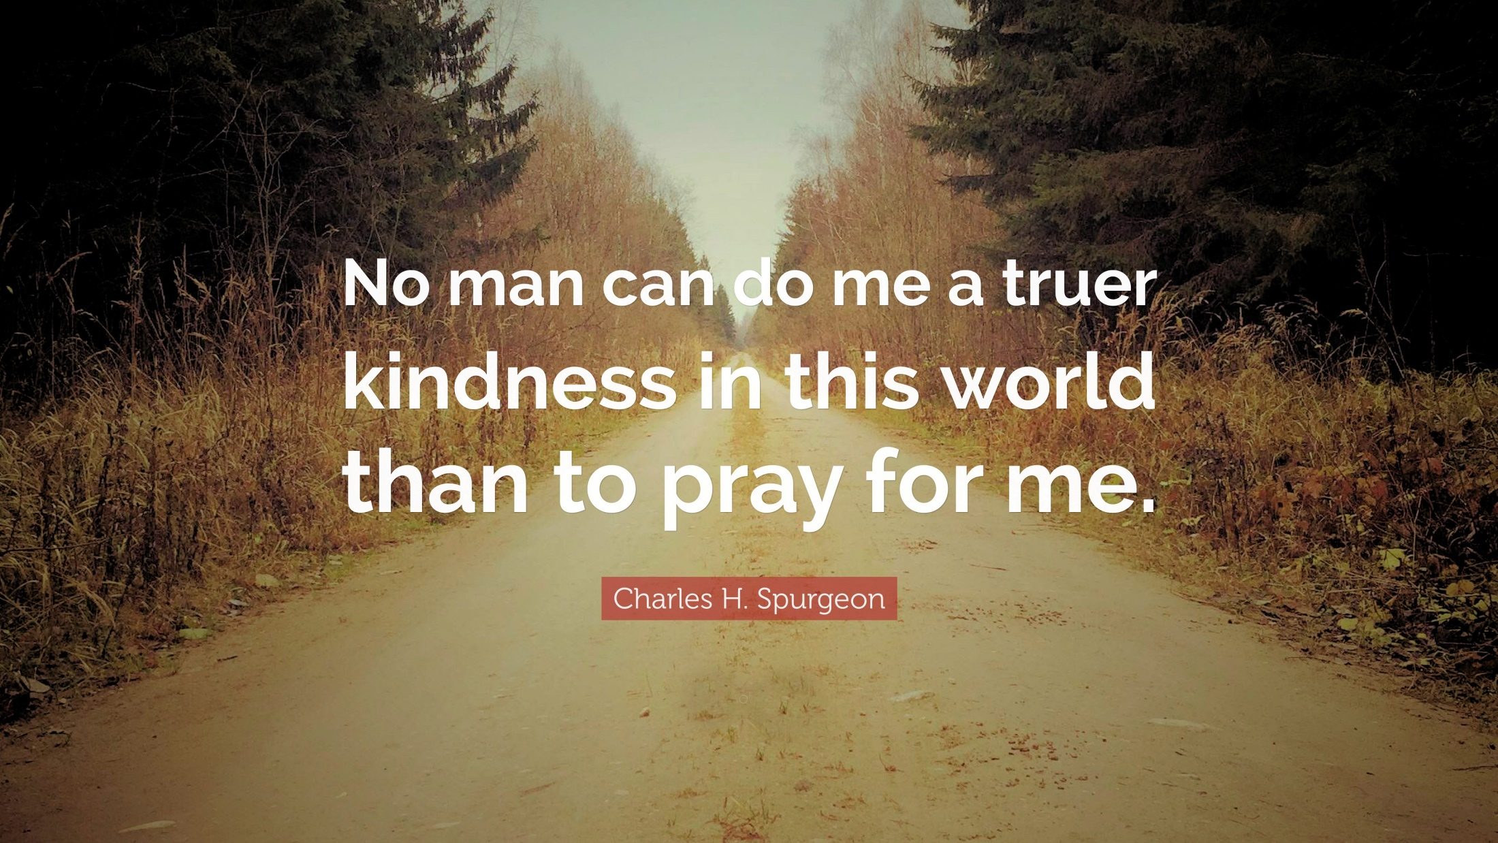

Slide 12
Charles Spurgeon
“Among all the formative influences that go to make up a man honored of God in the ministry, I know of none more mighty than the intercession of his parishioners. Without it, he will most likely be a failure!”

Slide 13
We are to pray that the gospel be communicated conceptually ^{(6:19b)}
that utterance may be given to me
This word “utterance” is the Greek word “logos” – “full expression of concepts or ideas”
To be given “utterance” is to be given the truths of God from God to communicate to others.

Slide 14
Rediscovering Expository Preaching
John MacArthur
Burn his eyes with weary study. Wreck his emotional poise with worry for God. And make him exchange his pious stance for a humble walk with God and man. Make him spend and be spent for the glory of God.

Slide 15
Rediscovering Expository Preaching
John MacArthur
Rip out his telephone. Burn up his ecclesiastical success sheets. Put water in his gas tank. Give him a Bible and tie him to the pulpit. And make him preach the Word of the living God!

Slide 16
Rediscovering Expository Preaching
John MacArthur
Test him. Quiz him. Examine him. Humiliate him for his ignorance of things divine. Shame him for his good comprehension of finances, batting averages, and political in-fighting. Laugh at his frustrated effort to play psychiatrist. Form a choir and raise a chant and haunt him with it night and day – “Sir, we would see Jesus.”

Slide 17
Rediscovering Expository Preaching
John MacArthur
When at long last he dares assay the pulpit, ask him if he has a word from God. If he does not, then dismiss him. Tell him you can read the morning paper and digest the television commentaries, and think through the day’s superficial problems, and manage the community’s weary drives, and bless the sordid baked potatoes and green beans, ad infinitum, better than he can.

Slide 18
Rediscovering Expository Preaching
John MacArthur
Command him not to come back until he’s read and reread, written and rewritten, until he can stand up, worn and forlorn, and say, “Thus saith the Lord.”

Slide 19
Rediscovering Expository Preaching
John MacArthur
Break him across the board of his ill-gotten popularity. Smack him hard with his own prestige. Corner him with questions about God. Cover him with demands for celestial wisdom. And give him no escape until he’s back against the wall of the Word.

Slide 20
Rediscovering Expository Preaching
John MacArthur
And sit down before him and listen to the only word he has left – God’s Word. Let him be totally ignorant of the down-street gossip, but give him a chapter and order him to walk around it, camp on it, sup with it, and come at last to speak it backward and forward, until all he says about it rings with the truth of eternity.

Slide 21
We are to pray that the gospel be communicated confidently^{(6:19c)}
in the opening of my mouth, to make known with boldness
Whether we open our mouths, or are seeking to make known some aspect of the gospel; it is the gospel that is to be communicated confidently, boldly, without reservation, with full conviction.

Slide 22
Acts 4:29-31
“29 And now, Lord, take note of their threats, and grant that Your bond-servants may speak Your word with all confidence, 30 while You extend Your hand to heal, and signs and wonders take place through the name of Your holy servant Jesus.” 31 And when they had prayed, the place where they had gathered together was shaken, and they were all filled with the Holy Spirit and began to speak the word of God with boldness.

Slide 23
We are to pray that the gospel be communicated clearly^{(6:19d)}
make known…the mystery of the gospel
ginosko – to know or understand something personally or intimately
gnorizo (used here in Ephesians 6:19) – to make something understandable or known to others

Slide 24
We are to pray that the gospel be communicated commitedly^{(6:20)}
for which I am an ambassador in chains; that in proclaiming it I may speak boldly, as I ought to speak.
Philippians 1:12-14 --- “12 Now I want you to know, brethren, that my circumstances have turned out for the greater progress of the gospel, 13 so that my imprisonment in the cause of Christ has become well known throughout the whole praetorian guard and to everyone else, 14 and that most of the brethren, trusting in the Lord because of my imprisonment, have far more courage to speak the word of God without fear.”

Slide 25
Marching Orders
Ephesians 6:10-17 - we are given the armor of God for our protection against the enemy.
Ephesians 6:18 - we are called to prayer and spiritual alertness in this war.
Ephesians 6:19-20 - we are called to specific prayer; that the gospel be communicated conceptually, confidently, clearly and committedly.

Slide 26
Big Idea of Ephesians 6:19-20
As a weapon in spiritual warfare, we are called to PRAY for one another; that the gospel be communicated conceptually, confidently, clearly, and committedly.

