Slide 2
Ephesians 6:10-12
10 Finally, be strong in the Lord and in the strength of His might. 11 Put on the full armor of God, so that you will be able to stand firm against the schemes of the devil. 12 For our struggle is not against flesh and blood, but against the rulers, against the powers, against the world forces of this darkness, against the spiritual forces of wickedness in the heavenly places.

Slide 3
Ephesians 6:13-15
13 Therefore, take up the full armor of God, so that you will be able to resist in the evil day, and having done everything, to stand firm. 14 Stand firm therefore, HAVING GIRDED YOUR LOINS WITH TRUTH, and HAVING PUT ON THE BREASTPLATE OF RIGHTEOUSNESS, 15 and having shod YOUR FEET WITH THE PREPARATION OF THE GOSPEL OF PEACE;

Slide 4
Ephesians 6:16-17
16 in addition to all, taking up the shield of faith with which you will be able to extinguish all the flaming arrows of the evil one. 17 And take THE HELMET OF SALVATION, and the sword of the Spirit, which is the word of God.

Slide 5
Consider
The Christian life = Spiritual Warfare
To seek to eliminate spiritual warfare from one’s spiritual life is to render your life unspiritual.

Slide 6
Romans 8:38-39
“For I am convinced that neither death, nor life, nor angels, nor principalities, nor things present, nor things to come, nor powers, nor height, nor depth, nor any other created thing, will be able to separate us from the love of God, which is in Christ Jesus our Lord.”

Slide 7
Big Idea of Ephesians 6:17b
To be successful in spiritual warfare, we must predetermine to be ready for battle by appropriating and incorporating each piece of our armor; taking the sword of the Spirit, which is the word of God; that is God’s truth aptly spoken and applied to any situation.

Slide 8
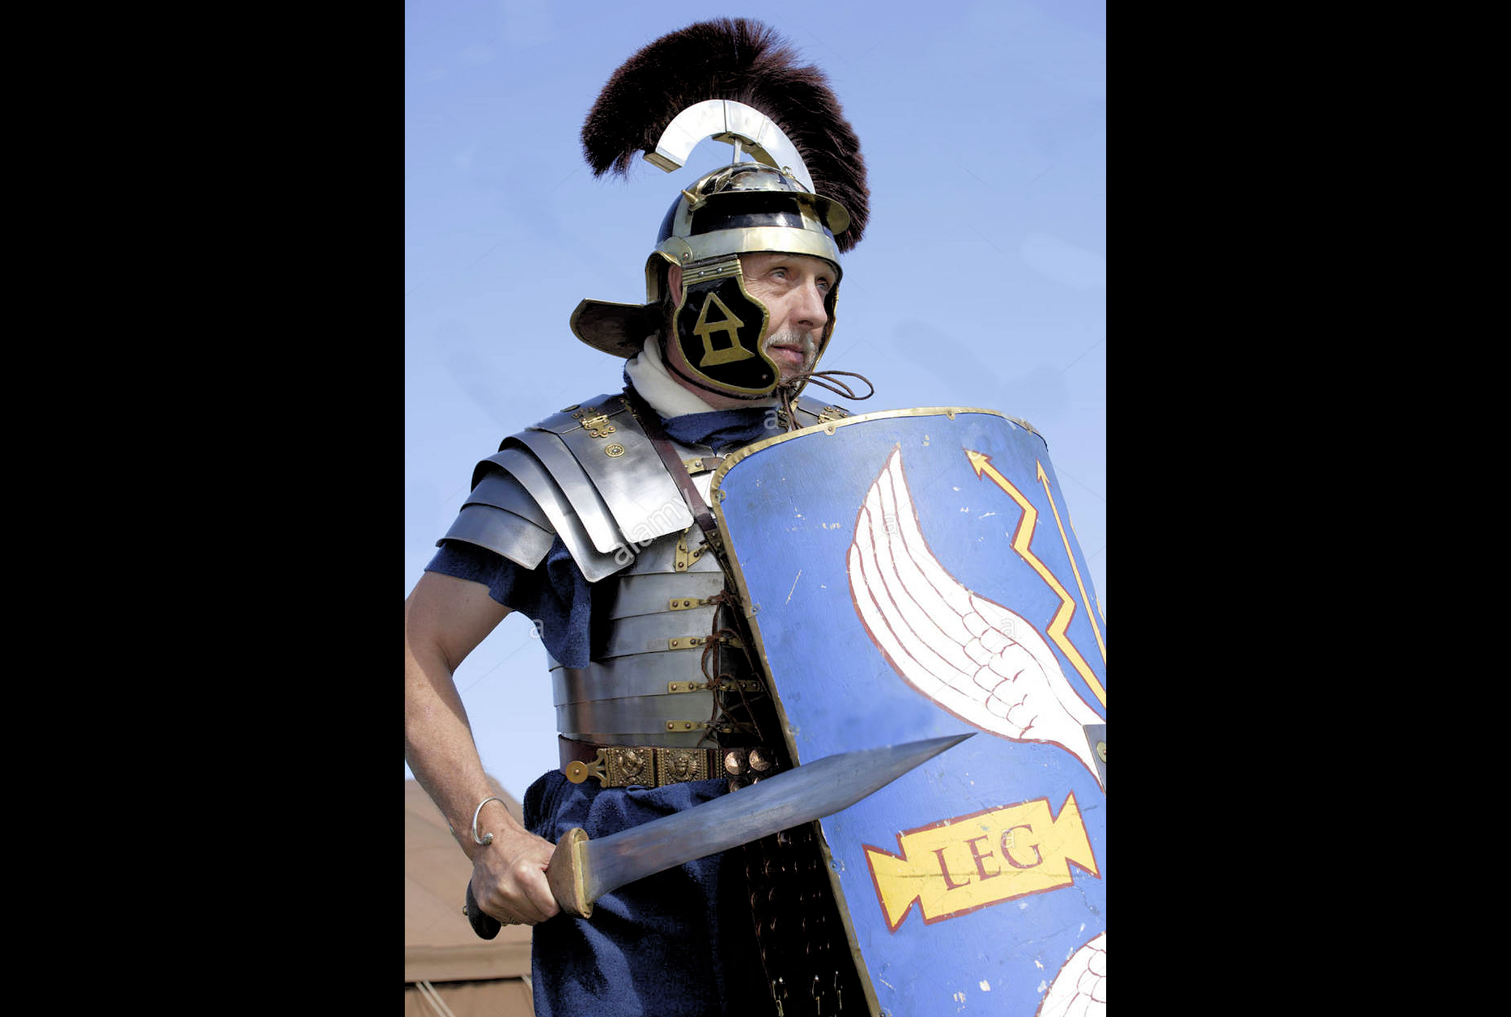
The Centurion Picture: the sword
Stand firm therefore…take…the sword of the Spirit (17b)
“machaira” – a short, double-edged sword that was light and easily maneuverable.

Slide 9
The Christian’s Provision: the sword of the Spirit…
Stand firm…and take…the sword of the Spirit…
The Sword of the LORD
Isaiah 27:1
“In that day the LORD will punish Leviathan the fleeing serpent, With His fierce and great and mighty sword…”

Slide 10
The Christian’s Provision: the sword of the Spirit…
Stand firm…and take…the sword of the Spirit, which is the word of God…
The Sword of Christ and the Spirit
“In His right hand He held seven stars, and out of His mouth came a sharp two-edged sword; and His face was like the sun shining in its strength.” (Revelation 1:16)
Literal translation: “take…the sword from the Spirit (as a gift); which is the word of God.”
“From His mouth comes a sharp sword, so that with it He may strike down the nations, and He will rule them with a rod of iron; and He treads the wine press of the fierce wrath of God, the Almighty.” (Revelation 19:5)

Slide 11
2 Peter 1:21
“for no prophecy was ever made by an act of human will, but men moved by the Holy Spirit spoke from God.”

Slide 12
The Christian’s Provision: the sword of the Spirit…
Stand firm…and take…the sword of the Spirit, which is the word of God…
What is the sword of the Spirit; the Word of God?
Not “logos” (lo/go$) which refers to all of the written Word or God, in its entirety.
But “rhema” (r(h=ma) which refers to the proclamation or speaking of individual verses and passages from the Scriptures. (also used in Ephesians 5:26).

Slide 13
H.A. Ironside
“The Bible is not the sword of the Spirit, it is the armory. There are thousands of swords in [the Bible] and every one of them is powerful and two-edged.”

Slide 14
Thomas Guthrie
“The Bible is an armory of heavenly weapons, a laboratory of infallible medicines, a mine of exhaustless wealth. It is a guidebook for every road, a chart for every sea, a medicine for every malady, and a balm for every wound.”

Slide 15
The Christian’s Provision: the sword of the Spirit…
Stand firm…and take…the sword of the Spirit, which is the word of God…
What is the sword of the Spirit; the Word of God?
The “logos” (lo/go$) the Word of God is the armory holding all the weapons.
The “rhema” (r(h=ma) individual verses or passages being proclaimed and spoken from the word of God – the individual swords from the armory.

Slide 16
Matthew 4:4
“It is written, 'MAN SHALL NOT LIVE ON BREAD ALONE, BUT ON EVERY WORD (“rhemati” – every individual word, saying, expression) THAT PROCEEDS OUT OF THE MOUTH OF GOD.'"

Slide 17
Consider
What God is looking for and what the church needs are…
Bible Experts

Slide 18
Where stands it written…?
Two Mormons tell you Jesus and Lucifer are brothers.
Jehovah’s Witnesses tell you Jesus is not truly, fully God.
A friend ask you how to get to heaven.
Your teenager questions the validity of your faith.
You are confronted with a personal sin and think that God cannot forgive you.

Slide 19
1 Peter 3:15
“but sanctify Christ as Lord in your hearts, always being ready to make a defense to everyone who asks you to give an account for the hope that is in you, yet with gentleness and reverence…”

Slide 20
John 16:13-15
13 But when He, the Spirit of truth, comes, He will guide you into all the truth; for He will not speak on His own initiative, but whatever He hears, He will speak; and He will disclose to you what is to come. 14 He will glorify Me, for He will take of Mine and will disclose it to you. 15 All things that the Father has are Mine; therefore I said that He takes of Mine and will disclose it to you.

Slide 21
John 14:24
“But the Helper, the Holy Spirit, whom the Father will send in My name, He will teach you all things, and bring to your remembrance all that I said to you.”

Slide 22
How the “rhema” of God works
The “rhema” of God destroys the arguments of our spiritual enemies (2 Corinthians 10:3-5).
The “rhema” of God softens the hard hearts of people by revealing to them the truth of their rebellion against God and of salvation through faith alone in Christ (Romans 10:17; Hebrews 4:12).
The “rhema” of God enables us to live increasingly God-glorifying, Christ-centered lives (Matthew 4:4).

Slide 23
The Christian’s Practice: “and take…the sword of the Spirit…”
Stand firm…and take…the sword of the Spirit, which is the word of God.
Immerse yourself into Scripture (Colossians 3:16).
The Word of God:
Read it; hear it; study it; memorize it; mediate on it; pray about it; pray through it; share it with others; converse with others about it…and then….do it some more!

Slide 24
Big Idea of Ephesians 6:17b
To be successful in spiritual warfare, we must predetermine to be ready for battle by appropriating and incorporating each piece of our armor; taking the sword of the Spirit, which is the word of God; that is God’s truth aptly spoken and applied to any situation.

