Slide 2
Ephesians 6:10-12
10 Finally, be strong in the Lord and in the strength of His might. 11 Put on the full armor of God, so that you will be able to stand firm against the schemes of the devil. 12 For our struggle is not against flesh and blood, but against the rulers, against the powers, against the world forces of this darkness, against the spiritual forces of wickedness in the heavenly places.

Slide 3
Ephesians 6:13-16
13 Therefore, take up the full armor of God, so that you will be able to resist in the evil day, and having done everything, to stand firm. 14 Stand firm therefore, HAVING GIRDED YOUR LOINS WITH TRUTH, and HAVING PUT ON THE BREASTPLATE OF RIGHTEOUSNESS, 15 and having shod YOUR FEET WITH THE PREPARATION OF THE GOSPEL OF PEACE. 16 in addition to all, taking up the shield of faith with which you will be able to extinguish all the flaming arrows of the evil one.

Slide 4
Numbers 13-14
The Spying out of the Land
The spying out of the land was not so they could determine what Israel could do, but rather it was for them to see what God was going to do.

Slide 5
Numbers 14:8-9
“8 If the LORD is pleased with us, then He will bring us into this land and give it to us — a land which flows with milk and honey. 9 Only do not rebel against the LORD; and do not fear the people of the land, for they will be our prey. Their protection has been removed from them, and the LORD is with us; do not fear them.”

Slide 6
Psalm 28:5
“The LORD is my strength and my shield; My heart trusts in Him, and I am helped.”

Slide 7
Summary of Ephesians 6:10-16
We are in a life and death battle for our testimonies and for the souls of the lost.
Main verb of Ephesians 6:10-20 – “be strong in the Lord and in the strength of His might” (v. 10)
How? By “putting on” and “taking up the full armor of God” (v. 11, 13)
How? “Stand firm” (v. 14) with the various pieces of the armor of God.

Slide 8
“Put on” and “Take up”
What believers “put on” | What believers “take up”
Belt of Truth (v. 14a) | The Shield of Faith (16)
Breastplate of Righteousness (v. 14b) | The Helmet of Salvation (17a)
Feet Shod with the Gospel of Peace (v. 15) | The Sword of the Spirit (17b)

Slide 9
Big Idea of Ephesians 6:16
To be successful in spiritual warfare, we must predetermine to be ready for battle by appropriating and incorporating each piece of our armor; taking up the shield of faith – which is a total trust and confidence in the Person and promises of God.

Slide 10
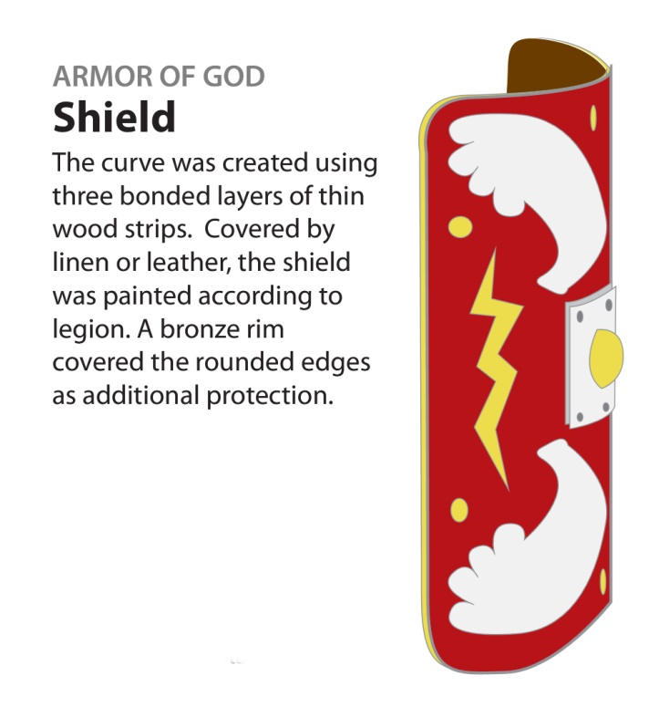
The Centurion Picture: the shield
Stand firm therefore…taking up the shield… (16)

Slide 11
The Christian’s Provision: the shield of faith
Stand firm…in addition to all, taking up the shield of faith with which you will be able to extinguish all the flaming arrows of the evil one.
Our Adversary –
The “evil one” – the devil
Flaming arrows - temptations
B. Our Defense –
A shield made to “extinguish” flaming arrows.

Slide 12
The Christian’s Practice: “taking up the shield of faith”
Stand firm…in addition to all, taking up the shield of faith with which you will be able to extinguish all the flaming arrows of the evil one.
Old Testament Imagery
“Then [Abraham] believed in the LORD; and He reckoned it to him as righteousness.”
Genesis 15:6
“After these things the word of the LORD came to Abram in a vision, saying, ‘Do not fear, Abram, I am a shield to you; Your reward shall be very great.’”
Genesis 15:1

Slide 13
Old Testament Imagery
“He will cover you with His pinions,
And under His wings you may seek refuge; His faithfulness is a shield and bulwark.”
Psalm 91:4
“Every word of God is tested;
He is a shield to those
who take refuge in Him.”
Proverbs 30:5

Slide 14
Psalm 28:5
“The LORD is my strength and my shield; My heart trusts in Him, and I am helped.”

Slide 15
Psalm 27:1
“The Lord is my light and my salvation; Whom shall I fear? The Lord is the defense of my life; Whom shall I dread?

Slide 16
The Christian’s Practice: “taking up the shield of faith”
Stand firm…in addition to all, taking up the shield of faith with which you will be able to extinguish all the flaming arrows of the evil one.
Living by faith
A total trust and confidence in the Person and promises of God

Slide 17
Romans 4:2-5
2 For if Abraham was justified by works, he has something to boast about, but not before God. 3 For what does the Scripture say? “ABRAHAM BELIEVED GOD, AND IT WAS CREDITED TO HIM AS RIGHTEOUSNESS.” 4 Now to the one who works, his wage is not credited as a favor, but as what is due. 5 But to the one who does not work, but believes in Him who justifies the ungodly, his faith is credited as righteousness…

Slide 18
Romans 10:17
“Faith comes from hearing,
and hearing by the Word of Christ.”

Slide 19
Temptations of Your Weaknesses
Identify your weakness: is it…
Anger
Lust
Laziness/slothfulness/procrastination
Ingratitude/bitterness/resentment
Pride/Self-focus/not thoughtful of others
Lying/deceitful
Neglect/ignorance of God and His Word
WHAT IS/ARE YOUR WEAKNESS(ES)?
WHAT DOES GOD’S WORD SAY ABOUT IT?

Slide 20
Romans 13:12-14
“12 The night is almost gone, and the day is near. Therefore let us lay aside the deeds of darkness and put on the armor of light. 13 Let us behave properly as in the day, not in carousing and drunkenness, not in sexual promiscuity and sensuality, not in strife and jealousy. 14 But put on the Lord Jesus Christ, and make no provision for the flesh in regard to its lusts.”

Slide 21
Big Idea of Ephesians 6:16
To be successful in spiritual warfare, we must predetermine to be ready for battle by appropriating and incorporating each piece of our armor; taking up the shield of faith – which is a total trust and confidence in the Person and promises of God.

