Slide 2
Ephesians 6:10-11
10 Finally, be strong in the Lord and in the strength of His might. 11 Put on the full armor of God, so that you will be able to stand firm against the schemes of the devil.

Slide 3
Ephesians 6:12-13
12 For our struggle is not against flesh and blood, but against the rulers, against the powers, against the world forces of this darkness, against the spiritual forces of wickedness in the heavenly places. 13 Therefore, take up the full armor of God, so that you will be able to resist in the evil day, and having done everything, to stand firm.

Slide 4
God’s 3-2-1 Battle Plan For Spiritual Warfare
3 precepts; 2 purposes; and 1 predicament.
The three precepts (commands): “Be strong…” (v.10a); “Put on…” (v. 11a); and “take up…” (v.13a).
The two purposes at the end of verses 11, 13; “so that you will be able to stand firm…” (v.11b); and “so that you will be able to resist in the evil day…” (v. 13b).
The one predicament in verse 12, that “our struggle…is against the spiritual forces of wickedness in the heavenly places.”

Slide 5
Big Idea of Ephesians 6:10
“To be successful in spiritual warfare we must consider:
the provision of God,
the practice of believers, and
the purposes of our God-given spiritual weaponry (the armor of God).”

Slide 6
I. The provision of God ^{(6:11a)}
“Put on the full armor of God…”
The command of the provision – “put on” – to sink into; to clothe or array.
The content of the provision – the armor of God (the Lord Himself)

Slide 7
Romans 13:14
“But put on the Lord Jesus Christ, and make no provision for the flesh in regard to its lusts.”

Slide 8
Ephesians 4:24
“and put on the new self, which in the likeness of God has been created in righteousness and holiness of the truth.”

Slide 9
I. The provision ^{(6:11a)}
“Put on the full armor of God…”
The command of the provision – “put on” – to sink into; to clothe or array.
The content of the provision – the armor of God (the Lord Himself)
The characteristics of the provision – a Roman Soldier.

Slide 10
Vegetius
“Victory in war does not depend entirely upon numbers or mere courage; only skill and discipline will insure it. We find that the Romans owed…the conquest of the world to no other cause than continual military training, exact observation of discipline in their camps and unwearied cultivation of the other arts of war.”

Slide 11
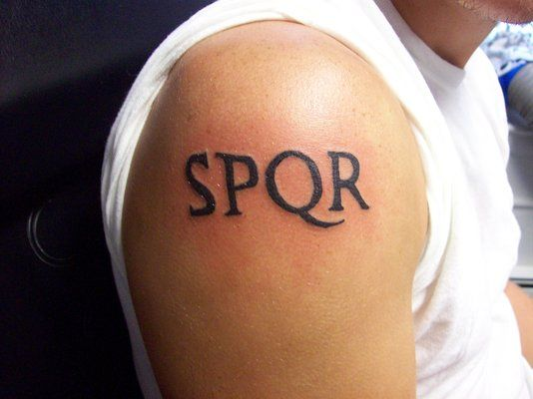
“The Senate and People of Rome”

Slide 12
Big Idea of Ephesians 6:10
“To be successful in spiritual warfare we must consider:
the provision of God,
the practice of believers, and
the purposes of our God-given spiritual weaponry (the armor of God).”

Slide 13
II. The practice of believers ^{(6:13a)}
“Take up the full armor of God…”
The command for the practice – “take up” – “to take hold of something; to seize something for use; to grasp something tightly.”
The illustration of the pocket knife.

Slide 14
III. The purposes ^{(6:11b; 13b)}
“so that you will be able to stand firm against the schemes of the devil (11b)…. so that you will be able to resist in the evil day, and having done everything, to stand firm. (13b)
“Stand firm” (“histemi”) - means “to stand one’s ground; be established; unmovable.”
“Resist” – (anthistemi) – means “to stand against; to oppose.”

Slide 15
1 Corinthians 10:12
“Therefore let him who thinks he stands take heed that he does not fall.”

Slide 16
Proverbs 24:10
“If you are slack in the day of distress, Your strength is limited.”

Slide 17
James 4:7
“Submit therefore to God. Resist [anthistemi] the devil and he will flee from you.”

Slide 18
1 Peter 5:8-9a
“8 Be of sober spirit, be on the alert. Your adversary, the devil, prowls around like a roaring lion, seeking someone to devour. 9 But resist [anthistemi] him, firm in your faith…”

Slide 19
2 Timothy 4:7
“I have fought the good fight, I have finished the course, I have kept the faith”

Slide 20
Big Idea of Ephesians 6:10
“To be successful in spiritual warfare we must consider:
the provision of God,
the practice of believers, and
the purposes of our God-given spiritual weaponry (the armor of God).”

