Slide 2
Ephesians 5:24-27
24 But as the church is subject to Christ, so also the wives ought to be to their husbands in everything. 25 Husbands, love your wives, just as Christ also loved the church and gave Himself up for her, 26 so that He might sanctify her, having cleansed her by the washing of water with the word, 27 that He might present to Himself the church in all her glory, having no spot or wrinkle or any such thing; but that she would be holy and blameless.

Slide 3
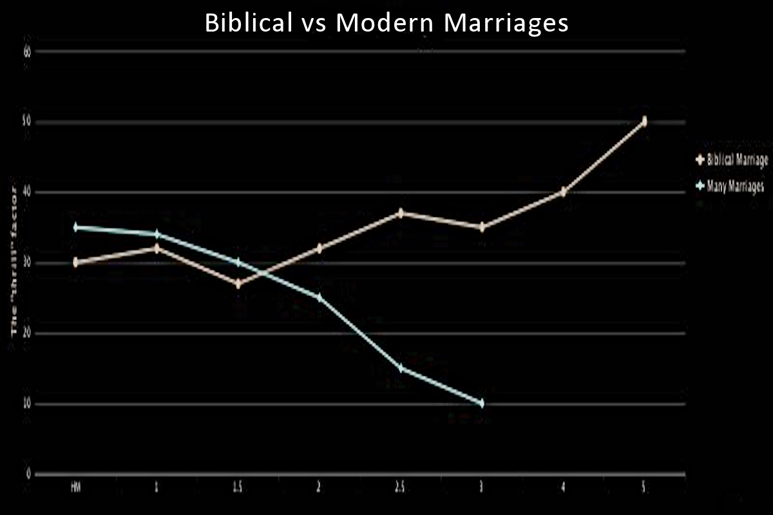

Slide 4
Thought
At the core of these verses is the kind of relationship every believer in Christ is to be actively engaged in as the “bride of Christ.”

Slide 5
Ephesians 5:25b-27
25b just as Christ also loved the church and gave Himself up for her, 26 so that He might sanctify her, having cleansed her by the washing of water with the word, 27 that He might present to Himself the church in all her glory, having no spot or wrinkle or any such thing; but that she would be holy and blameless.

Slide 6
Hebrews 12:14-16
“14 Pursue peace with all men, and the sanctification without which no one will see the Lord. 15 See to it that no one comes short of the grace of God; that no root of bitterness springing up causes trouble, and by it many be defiled; 16 that there be no immoral or godless person like Esau, who sold his own birthright for a single meal.”

Slide 7
Big Idea of Ephesians 5:24-27
Husbands and wives, as believers in Christ, are to be pursuing the perfection of Christ for themselves and for one another, thus modeling mutual sanctification.

Slide 8
I. The perfecting of the married couple
that He might present to Himself the church in all her glory, having no spot or wrinkle or any such thing; but that she would be holy and blameless.
Ephesians 5:27
“8 For man does not originate from woman, but woman from man; 9 for indeed man was not created for the woman's sake, but woman for the man's sake.”
1 Corinthians 11:8-9

Slide 9
The “wrong ways” to perfect your spouse
Having a critical attitude toward them (privately or publically).
Being silent about their faults and sins.
Comparing them to other people.
Nagging them about something.
Manipulating them, bribing them with affection or other “favors” when they do what you want them to do.
Being passive-aggressive (giving them the “silent treatment”; the cold-shoulder; sulking around or withdrawing; crying to forge sympathy, finding things about which to be or remain angry about).

Slide 10
II. The perfecting of a husband
The wife makes sure her husband knows she respects him (5:33).
“respects” – literally “fear” – in context, not in cowering or terror, but rather “purposing not to bring displeasure or disappointment.”

Slide 11
II. The perfecting of a husband
The wife actively acknowledges her husband as her head (5:23).
Ephesians 5:23 – “For the husband is the head of the wife…”

Slide 12
II. The perfecting of a husband
The wife purposely and routinely communicates with her husband.
“For the husband is the head of the wife…” (v. 23)
“Be anxious for nothing, but in everything by prayer and supplication with thanksgiving let your requests be made known to God” (Philippians 4:6).
“Trust in Him at all times, O people; Pour out your heart before Him; God is a refuge for us.”
(Psalm 62:8).

Slide 13
II. The perfecting of a husband
The wife seeks to discern and understand her husband’s desires.
“For the husband is the head of the wife…” (v. 23)

Slide 14
II. The perfecting of a husband
The wife maintains a complete confidence in the sovereignty of God in her relationship to her husband.
“Wives, be subject to your own husbands, as to the Lord” (Ephesians 5:22).

Slide 15
III. The perfecting of a wife
The husband makes sure that his wife knows he loves her.
“Husbands, love your wives…” (Ephesians 5:25; and 33).
“Little children, let us not love with word or with tongue, but in deed and truth.”
1 John 3:18

Slide 16
III. The perfecting of a wife
The husband honors his wife as his helpmeet.
“Husbands, love your wives…” (Ephesians 5:25; and 33).
“…in the same way, live with your wives in an understanding way, as with someone weaker, since she is a woman; and show her honor as a fellow heir of the grace of life, so that your prayers will not be hindered.”
1 Peter 3:7

Slide 17
III. The perfecting of a wife
The husband purposely and routinely communicates with his wife.
“Husbands, love your wives…” (Ephesians 5:25; and 33).
The advice of D. Martyn-Lloyd Jones to husbands:
“Make yourself talk!”

Slide 18
III. The perfecting of a wife
The husband devotes his efforts to cleansing, nourishing and cherishing his wife.
“for no one ever hated his own flesh, but nourishes and cherishes it…” (Ephesians 5:29)

Slide 19
IV. The perfect relationship
The husband shows his true character by what his wife becomes.
“that He might present to Himself the church in all her glory, having no spot or wrinkle or any such thing; but that she would be holy and blameless.” (Ephesians 5:27)

Slide 20
IV. The perfect relationship
The husband and wife relationship is to be a testimony of the power of the gospel.
“that He might present to Himself the church in all her glory, having no spot or wrinkle or any such thing; but that she would be holy and blameless.” (Ephesians 5:27)
“By this all men will know that you are My disciples, if you have love for one another.”
(John 13:35)

Slide 21
D. Martyn-Lloyd Jones
“There is not greater recommendation to the truth and power of the Christian faith, than a Christian husband and wife, a Christian marriage, a Christian home.”

Slide 22
IV. The perfect relationship
The husband and wife relationship is to be a continually growing experience.
“that He might present to Himself the church in all her glory, having no spot or wrinkle or any such thing; but that she would be holy and blameless.” (Ephesians 5:27)
A marriage is either progressively perfecting the husband and wife to Christlikeness or it is digressing into something other than what God desires.

Slide 23
Questions
To Husbands: How can I become more like Christ, loving my wife like He did the Church?
To Wives: How can I show increasing respect and honor to my husband, even as the Church does to Christ?
To Husbands and Wives: How can I encourage my wife/my husband in these things?
To all: How might I encourage married couples to better model these things?

