Slide 2
Ephesians 5:25-27
25 Husbands, love your wives, just as Christ also loved the church and gave Himself up for her, 26 so that He might sanctify her, having cleansed her by the washing of water with the word, 27 that He might present to Himself the church in all her glory, having no spot or wrinkle or any such thing; but that she would be holy and blameless.

Slide 3
Ephesians 5:28-30
28 So husbands ought also to love their own wives as their own bodies. He who loves his own wife loves himself; 29 for no one ever hated his own flesh, but nourishes and cherishes it, just as Christ also does the church, 30 because we are members of His body.

Slide 4
A “REAL” Man…
The greatest thing a man can do for a woman
is to lead her closer
to Christ than to himself.

Slide 5
What is marriage?
Marriage is, at its core, to be an evangelistic witness of the life-transforming nature of being rightly related to Christ.

Slide 6
John 13:34
“A new commandment I give to you, that you love one another, even as I have loved you, that you also love one another.”

Slide 7
LOVE
Ephesians 5:2 - “…walk in love, just as Christ also loved you and gave Himself up for us..”
Ephesians 5:25 – “Husbands, love your wives, just as Christ also loved the church and gave Himself up for her…”

Slide 8
The “big idea” of Ephesians 5:25-30
The husband is to live out a love
for his wife that demonstrates
the affection of Christ for the Church.

Slide 9
A “working” definition of love…
“Love is a one-way, unconditional act of the will and motivation of the heart that seeks the highest good for another, regardless of the cost and all to the glory of God.”

Slide 10
The dual “big idea” of Ephesians 5:25-30
What is the love of Christ
for His Church
and how is it demonstrated?

Slide 11
Ephesians 5:25-29…Christ…
Loved the church (5:25)
Gave Himself for the church (5:25)
Will sanctify the church (5:26)
Will present the church (5:27)
Nourishes the church (5:29)
Cherishes the church (5:29)

Slide 12
Christ loved the church ^{(v. 25)}
“Husbands, love your wives, just as Christ also loved the church…(5:25)
“Love is a one-way, unconditional act of the will and motivation of the heart that seeks the highest good for another, regardless of the cost and all to the glory of God.”

Slide 13
Christ gave Himself up for the church ^{(v. 25)}
“Husbands, love your wives, just as Christ also loved the church and gave Himself up for her…(5:25)
Jesus said, “17 For this reason the Father loves Me, because I lay down My life so that I may take it again. 18 No one has taken it away from Me, but I lay it down on My own initiative.” (John 10:17-18)
“To Him who loves us and released us from our sins by His blood…” (Revelation 1:5)

Slide 14
Romans 5:8
“But God demonstrates His own love toward us, in that while we were yet sinners, Christ died for us.”

Slide 15
Christ will sanctify the church ^{(v. 26)}
“so that He might sanctify her, having cleansed her by the washing of water with the word…”(5:26)
To “sanctify” speaks of being made holy, being made set apart for a special purpose.
“To Him who loves us and released us from our sins by His blood…” (Revelation 1:5)

Slide 16
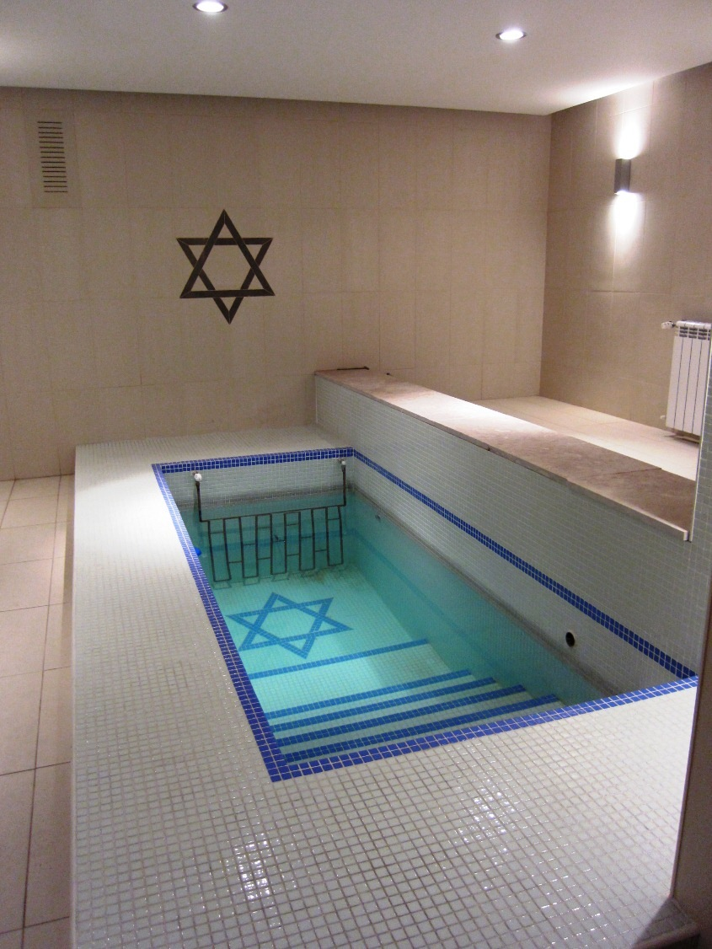
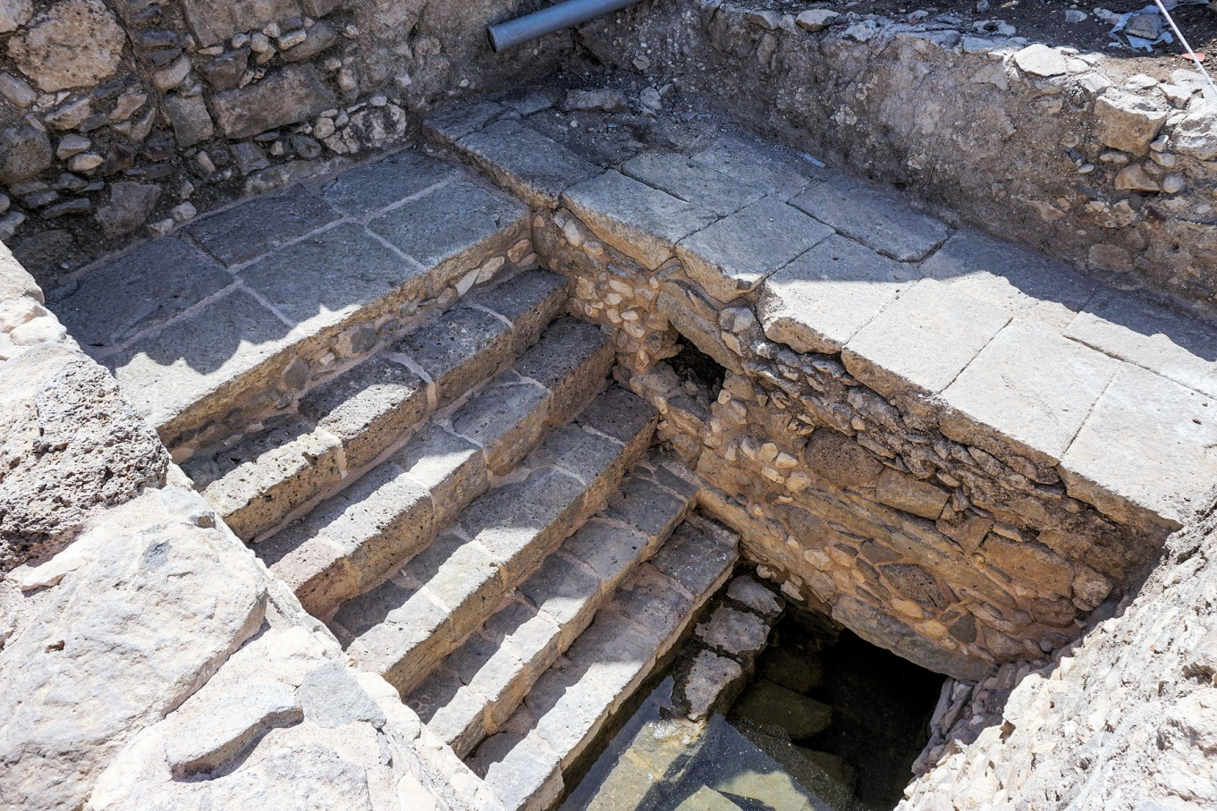
“Mikveh” – ritual bath
Ancient Mikveh
Modern Mikveh

Slide 17
John MacArthur
“…a Christian husband should not be able to bear the thought of anything sinful in the life of his wife that displeases God. His greatest desire for her should be that she become perfectly conformed to Christ, so he [intentionally] leads her to purity [Christlikeness].”

Slide 18
Christ will present the church ^{(v. 27)}
“that He might present to Himself the church in all her glory, having no spot or wrinkle or any such thing; but that she would be holy and blameless.…”(5:27)

Slide 19
Christ nourishes the church ^{(v. 29)}
“29 for no one ever hated his own flesh, but nourishes and cherishes it, just as Christ also does the church, 30 because we are members of His body.”
Nourishes - providing what is necessary for sustaining, growth and protection

Slide 20
Christ cherishes the church ^{(v. 29)}
“29 for no one ever hated his own flesh, but nourishes and cherishes it, just as Christ also does the church, 30 because we are members of His body.”
Cherishes – taking tender care and giving special attention to the needs of another as is if they were your own.

